Slide 1


Slide 2
Theme 5 - Overview
Systems Change and Collective Action

Slide 3
Theme 5: main objectives
Universal stories for universal access
Systems changes requires co-creation and locally
led solutions
Applying systems thinking and collective action at a strategic and practical level

Slide 4
Session 1: Decolonizing the WASH narrative to promote systems change, part 1: Disrupting the single story
Theme 5: Systems thinking and collective action

Slide 5
Session objectives
Recognise the need to address inequities in the WaSH workforce to achieve SDG6 by:
Understanding the manifestations and causes of inequity in WaSH research/implementation
Realising our positions and responsibility to overcome barriers to equity in WaSH research/implementation
Notes:
The session objective is to recognise the need to address inequities in the WaSH workforce to achieve SDG6 by:
Understanding the manifestations and causes of inequity in WaSH research/implementation
Realising our positions and responsibility to overcome barriers to equity in WaSH research/implementation

Slide 6
Session format
Icebreaker
Barriers to equity faced by LMIC researchers
Positionality to overcome barriers
Reimagining data for systems change
World Cafe
Notes:
In this session – we will have an interactive ice breaker

Slide 7

SLIDO
What motivates you to do WASH work?
ⓘ Start presenting to display the poll results on this slide.
Notes:
📣 This is Slido interaction slide, please don't delete it.
✅ Click on 'Present with Slido' and the poll will launch automatically when you get to this slide.

Slide 8
SLIDO
Defining colonization - What comes to mind when you think of coloniality, colonization, and (neo)colonialism?
ⓘ Start presenting to display the poll results on this slide.
Notes:
📣 This is Slido interaction slide, please don't delete it.
✅ Click on 'Present with Slido' and the poll will launch automatically when you get to this slide.

Slide 9
SLIDO
Defining colonization - What comes to mind when you think of coloniality, colonization, and (neo)colonialism?
ⓘ Start presenting to display the poll results on this slide.
Notes:
📣 This is Slido interaction slide, please don't delete it.
✅ Click on 'Present with Slido' and the poll will launch automatically when you get to this slide.

Slide 10
SLIDO
Defining decolonization - What comes to mind when you think of decoloniality, decolonization, equity,
or justice?
ⓘ Start presenting to display the poll results on this slide.
Notes:
📣 This is Slido interaction slide, please don't delete it.
✅ Click on 'Present with Slido' and the poll will launch automatically when you get to this slide.

Slide 11



Section 1:
Barriers to equity faced by LMIC researchers

Slide 12
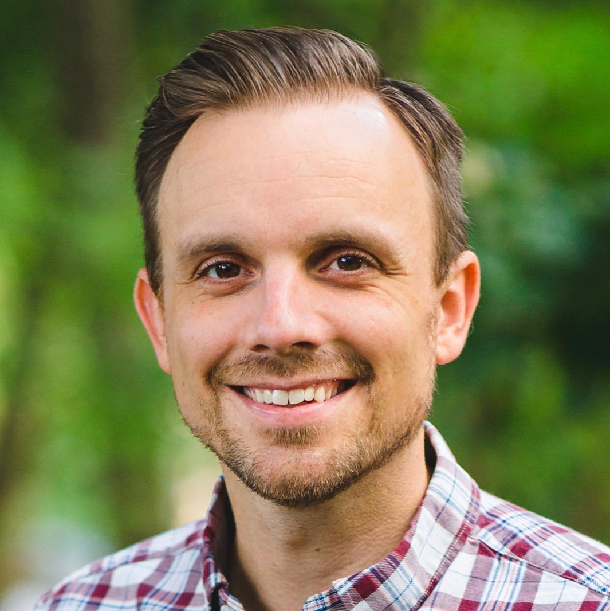
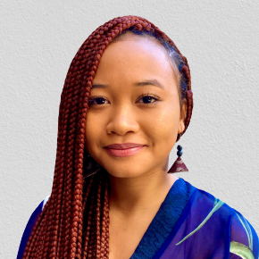
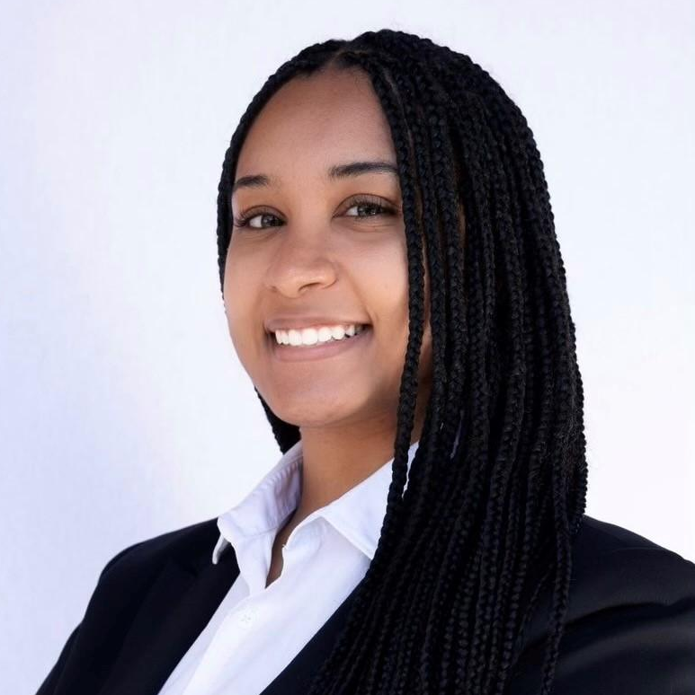
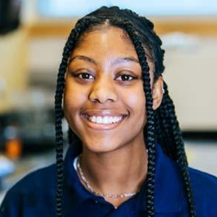
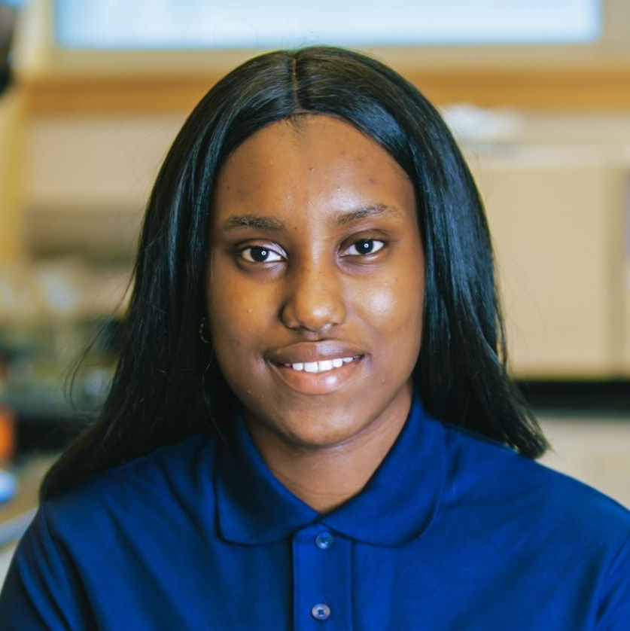

Research Team
James Ben Tidwell
J’Anna-Mare Lue
Kaelah Grant
Leila Nzekele
Salamata Bah
Justine Lee
World Vision, Inc.
btidwell@worldvision.org
UC Berkeley
Drexel University*
luejannamare@gmail.com
Drexel University
kyg26@drexel.edu
Drexel University*
lgn23@dragons.drexel.edu
Drexel University
sb4255@drexel.edu
World Vision, Inc.
julee@worldvision.org
Notes:
Hello, My name is J’Anna Lue, I am a first year Civil and Environmental Engineering PhD student at the University of California, Berkeley. Today, I will be presenting “Principles for increasing equity in WASH research: Understanding barriers faced by LMIC WASH researchers” a joint research effort conducted by Drexel University and World Vision.

Slide 13
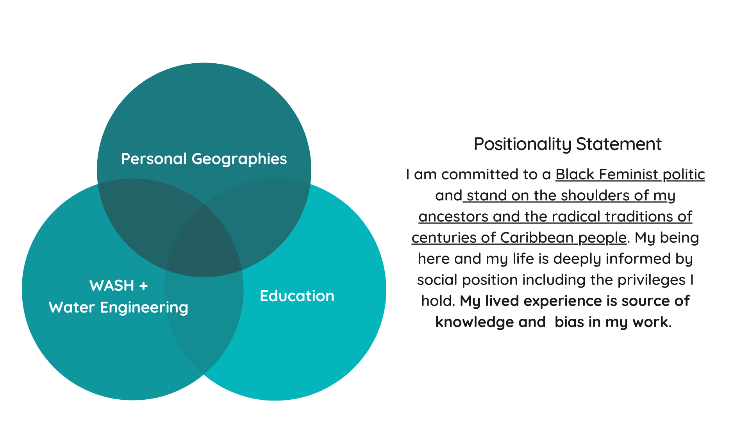
Presenter positionality
Notes:
To better introduce myself and the viewpoint I bring to research I have prepared a positionality statement. I am a Jamaican-born woman of Afro-Caribbean and Hakka Chinese descent. I grew up in a rural coastal town in Jamaica. But, I have spent my entire adult life in the United States where I have been studying since 2017. I graduated with a Bachelor’s and Master’s in Environmental Engineering last year, and despite my obvious commitment to engineering - I truly value interdisciplinary education. As for my professional experience with water and WASH, I have two months WASH field research experience, three years WASH project experience, and a year of water engineering experience.
I am committed to a Black feminist politic and stand on the shoulders of my ancestors and the radical traditions of centuries of Caribbean people. I acknowledge that my being here - being able to give this talk and being engaged in academia, etcetera, is deeply informed by my social position including privileges I hold. My lived experiences are a source of knowledge and bias in my work.

Slide 14
Introduction
Project Motivation
Colonial legacies of global health
Growing public awareness of unjust systems
Project Objectives
Identify inequalities in the WASH research landscape faced by LMIC researchers
Explore feasible strategies for moving toward a more equitable future.
Notes:
This project was inspired by longstanding critiques of colonial legacies that influence global health AND growing public awareness of unjust systems - seemingly due to increased awareness of racialised state violence as well as economic and health inequities made pronounced by the COVID-19 pandemic.
This project aimed to investigate inequalities in WASH by centering the experiences of LMIC researchers, examining the root causes of inequity and exploring feasible strategies for moving toward a more equitable future. The qualitative data collected reflects the challenges faced by LMIC WASH researchers underscoring relevance of decolonisation and equity-building initiatives in the sector.

Slide 15
Colonial Roots of Global Health
Continued partnerships between former colonizing countries & former colonized countries
Why Research Equity?
Role of multilateral and humanitarian organizations in Western hegemony
1 - Pearson, J. L. (2017). Defending Empire at the United Nations: the politics of international colonial oversight in the era of decolonisation.
2 - Levich, J. (2015). The gates foundation, Ebola, and global health imperialism.
Notes:
So why should the WASH sector be considering research equity? Global health is descended from colonial and tropical medicine. This dynamic influences the present day WASH sector. There are still partnerships between former colonizing countries (typically HIC) and formerly colonized countries (typically LMIC). Many of these relationships are extractive in nature. Multilateral organizations and NGOS set much of the WASH agenda and are key funders. However, multilateral organizations also advance the economic and political power of their key members. Humanitarian organizations and NGOs also promote the “hegemony of neoliberal institutions while reinforcing the ideology of the Western ruling class.” ^{1, 2}

Slide 16
Theoretical framing
Decolonization is a verb…
Intersectionality is a lens…
Epistemic violence is a dismissal…
3 - Kessi, S., Marks, Z., & Ramugondo, E. (2020). Decolonizing African Studies.
4 - Crenshaw, K. (1989). Demarginalizing the intersection of race and sex: A Black feminist critique of antidiscrimination doctrine, feminist theory, and antiracist politics
5 - Ymous, A., Spiel, K., Keyes, O., Williams, R. M., Good, J., Hornecker, E., & Bennett, C. L. (2020). " I am just terrified of my future"—Epistemic Violence in Disability Related Technology Research.
6 - Spivak, G. C. (1988). Can the subaltern speak?
Notes:
There were three important concepts used to frame this project. Decolonization, which is defined by Kessi et al. as “a verb that entails a political and normative ethic and practice of resistance and intentional undoing – unlearning and dismantling unjust practices, assumptions, and institutions – as well as persistent positive action to create and build alternative spaces and ways of knowing.” Intersectionality, a term coined by Kimberle Crenshaw, who describes “a lens through which you can see where power comes and collides, where it interlocks and intersects.” And Finally, epistemic violence, first introduced by post-colonial feminist scholar Gayatri Spivak, however, we use the following definition “violence against one’s status as a knower; one’s role as a creator and communicator of knowledge... the dismissal of people as credible sources of information, because of our presumptions about them.” by Ymous et al.

Slide 17
Methods
Semi-structured Interviews
19 LMIC Researchers
6 Donor Representatives
Literature Review
Review of 30 articles, books, and other sources from multiple disciplines
Notes:
A semi-structured interview guide was used to ask LMIC researchers about experiences with discrimination and mitigating strategies to combat discrimination. Participants were prompted to voice their own experiences or those they directly observed. A similar but separate semi-structured interview guide was developed for interviews with donor representatives who were invited to focus their responses on organizational experience. 24 interviews were conducted with 19 LMIC researchers and 6 donor representatives. For the most part we will focus on the LMIC researchers’ responses.

Slide 18
Coding framework
01
Power Differentials and Abuse of Power
02
Structural Barriers due to Organizational Policies
03
Institutional and Individual Indifference
04
Othering Speech, Action, and Practices
05
Context-specific discrimination
Notes:
Interviews were transcribed, and then coded or analyzed to identify themes. Five interrelated themes emerged from the qualitative data based on discriminatory experiences - power differentials or abuse of power, structural barriers due to organizational politics, institutional and individual indifference, othering speech, action, and practices, and context-specific discrimination.

Slide 19
01
Power Differentials and Abuse of Power
Inequitable balance of responsibilities
Inequitable distribution of authorship and acknowledgment
“We had that terrible experience where one of the partners actually solely wrote an article with her name alone on it. [We contributed to the] paper by data collection, answering many questions, writing reports, and then this person turns out to write a paper on her own… [This] set a terrible precedent considering that she's not come even down yet to collect that data.”
Researcher 16 - Late-career Woman
Notes:
Participants noted cases of overt abuse of power as well as power differentials throughout the research process. Some ways this code showed up included: inequitable balance of responsibilities, acknowledgements, and authorship roles. One late career-woman said “We had that terrible experience where one of the partners actually solely wrote an article with her name alone on it. [We contributed to the] paper by data collection, answering many questions, writing reports, and then this person turns out to write a paper on her own… [This] set a terrible precedent considering that she's not come even down yet to collect that data.”

Slide 20
02
Structural Barriers Due to Organizational Policy
Incompatibilities between wider research community priorities and researched communities priorities
Discriminatory policies related to budget
“There were a few cases where that particular component of the work can be done by nationals, but you still have to find internationals flying in to do the same. So, you could see that some of these trips [and their costs] are probably not justified.”
Researcher 2—Late-career man
Notes:
Researchers in LMICs face many structural barriers that are attributed to either formal organisational policies or informal relationships. Some examples include: misaligned research priorities, and discriminatory policies related to budgeting. One late-career man said “There were a few cases where that particular component of the work can be done by nationals, but you still have to find internationals flying in to do the same. So, you could see that some of these trips [and their costs] are probably not justified.”

Slide 21
03
Institutional and Individual Indifference
Impacts of English as the predominant language for everyday interactions and knowledge dissemination
Use of western metrics when evaluating competency
“English language is not the language of the people on whom, or with whom I do research? So, I would like to think that other than funding, language is the biggest barrier. Not like English, but academic English, but the hegemonic power of English as a language.”
Researcher 12 - Early-career Woman
Notes:
Institutional and individual indifference to inequity appeared in several ways. Major barriers identified included: English hegemony and the use western metrics to evaluate competency. One early-career woman shares “English language is not the language of the people on whom, or with whom I do research. So, I would like to think that other than funding, language is the biggest barrier. Not like English, but academic English, but the hegemonic power of English as a language.”

Slide 22
04
Othering Speech, Action, and Practices
From funders or funder representatives
From journals, publishers, and peer reviewers
“So in [LMIC], I have got this institution where I sometimes guest lecture. There was this interesting student who did something that I was interested in. I said, Okay, why don't we publish it and we wrote it. [We submitted with the student as the first author, with our affiliation being the LMIC university and it ] was rejected. And we wrote it back with my affiliations as [HIC university] and putting me as the first author in the same journal, it was accepted.”
Researcher 5 - Early-career Man
Notes:
Othering speech, action and practices refer to the intentional and unintentional discrimination of an individual
based on one or more social categories or identities that an individual may hold. Othering can come from funders, journals, within organizations, and communities. One early career man says “So in [LMIC], I have got this institution where I sometimes guest lecture. There was this interesting student who did something that I was interested in. I said, Okay, why don't we publish it and we wrote it. [We submitted with the student as the first author, with our affiliation being the LMIC university and it ] was rejected. And we wrote it back with my affiliations as [HIC university] and putting me as the first author in the same journal, it was accepted.”

Slide 23
04
Context-specific Discrimination
Caste-based discrimination
Tribal discrimination
“You'll see that many white-collar jobs often are exclusive of people who identify with the lower caste within the caste system. Within the government offices and NGOs, you'll often find that while these tend to be the communities that tend to be beneficiaries, they're not necessarily included as staff or professional workers.”
Researcher 18 - Early-career Woman
Notes:
Context-specific discrimination refers to the issues of tribal discrimination, caste-based discrimination and other forms of discrimination characteristic to specific communities where research is taking place. One early-career woman says ““You'll see that many white-collar jobs often are exclusive of people who identify with the lower caste within the caste system. Within the government offices and NGOs, you'll often find that while these tend to be the communities that tend to be beneficiaries, they're not necessarily included as staff or professional workers.”

Slide 24
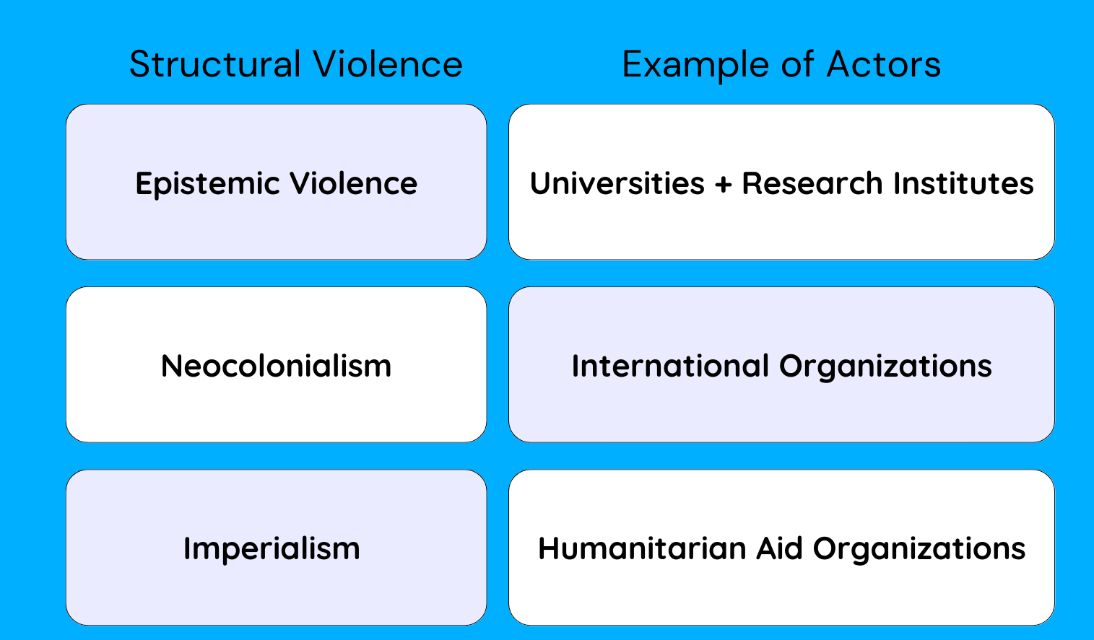
WASH and Violence
WASH is at the convergence of multiple violent systems.
3 - Mayorga, E., Leidecker, L., & De Gutierrez, D. O. (2019). Burn It Down: The Incommensurability Of The University And Decolonization.
4 - Rahaman, Shafiqur M. (2017). The Untold History of Neocolonialism in Africa (1960-2011).
5 - Aloudat, T., & Khan, T. (2022). Decolonising humanitarianism or humanitarian aid?
Notes:
WASH is at the convergence of multiple violent systems. Universities and research institutions also serve as the birthplace of epistemic violence in the context of colonialism. The physical, social, and psychic violence of colonization that forms the modern university as the sole credible producer and regulator of knowledge erases the indigenous and local knowledges and their validity³ The formation of international organizations coincides with the decolonization period of the 1940s-1970s when former colonies gained independence. These organizations are “agents of former imperialist countries” ⁴ that foster and uphold neo-colonialism. Humanitarian aid organization which funds many global health initiatives are an “[instrument] to serve the continuation of centuries of colonialism, warmongering, and economic exploitation.”⁵ Global health philanthropy, though the actors are non-governmental, often bolsters the hold of Western imperialism in the Global South.¹

Slide 25
Imagining Equitable WASH Research
Achieving equity, decolonization, and/or justice is reparative.
Authorship
Epistemic Violence
Funding & Capacity Building
Notes:
From our findings, we identified the following critical issues:
reducing inequities in authorship,
adequately funding and resourcing LMIC researchers and institutions,
focusing on capacity building,
and addressing epistemic violence within WASH.

Slide 26
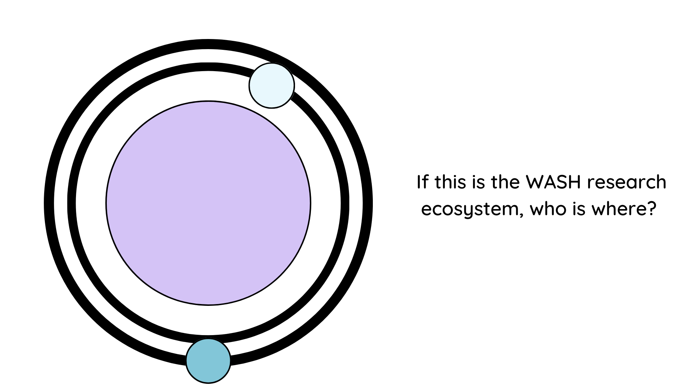
Imagining Equitable WASH Research
“to be in the margin is to be part of the whole but outside the main body.”
[bell hooks]
Notes:
The WASH sector emphasizes the inequities in access to WASH infrastructure and services, and the human right of access to clean water and adequate sanitation. However, LMIC communities, researchers, and institutions are often on the margins of WASH research despite being more reflective of target populations. Research equity begins with the acknowledgment of systems of inequalities by all actors, specifically those who control resources and episteme.
There are only a few articles addressing decolonization, equity, and justice in WASH research space which typically penned by LMIC authors. However, we can draw upon generations of scholars within the areas of post-colonial, decolonial, queer, and ethnic studies as well as Black & global feminist and liberation movements whose strategies and frameworks of justice and decolonization can contextualized to improve equity in WASH.
To be in the margins is to be a part of the whole, but outside the main body. bell hooks. If this image represents a simplified WASH ecosystem. Who is at the center? Where do LMIC researchers go? What about researchers with more than one non-dominant identity? Where do communities members go?

Slide 27
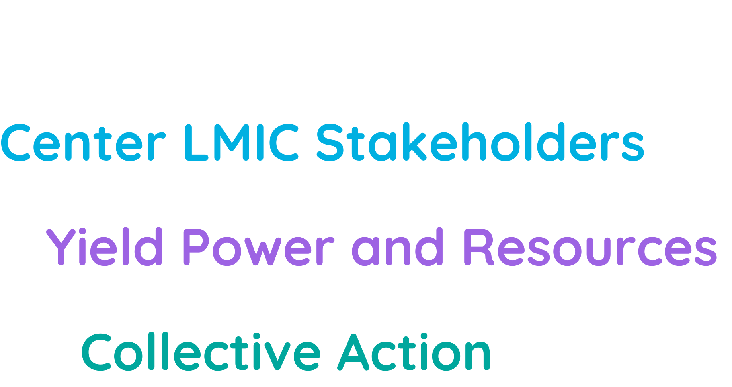
Imagining Equitable WASH Research
Notes:
Decolonization & improving research equity must center LMIC stakeholders, bringing them to the forefront to tell their own stories, set research agendas, and gain credit. Centering requires the “yielding of power” and resources to stakeholders who are discriminated against and oppressed based on social and geopolitical factors. Collective action is needed to distribute the power for a more just WASH research landscape. Rather than placing the burden on LMIC researchers to assimilate into unjust systems, the onus of building equity is on sector leaders, leaders of WASH organizations, funders, conference organizers, and publication boards who must reshape their operations to subvert cultures of domination and inequitable resource distribution.

Slide 28
Section 2: Positionality to increase equity
Euphresia Luseka

Slide 29
I am a African woman born and raised in Nairobi, Kenya.
I hold a Msc. On Education for Sustainability from London South Bank University. As a Water Governance Specialist I understand that the disciplines in which I have been trained have significant histories (continuing to the present) as tools of colonisation. I bring the experience of both my cultural heritage and my professional development to my research. Towards bringing a more comprehensive view to my research, I recognize my positionality is shaped by my privilege and access to some resources, and I strive to be aware of my own biases and recognize how these may shape my research.
Presenter Positionality
Notes:
Positionality statements help us become conscious of our own subjectivity in order to consider how this subjectivity might shape our work within a particular context.

Slide 30
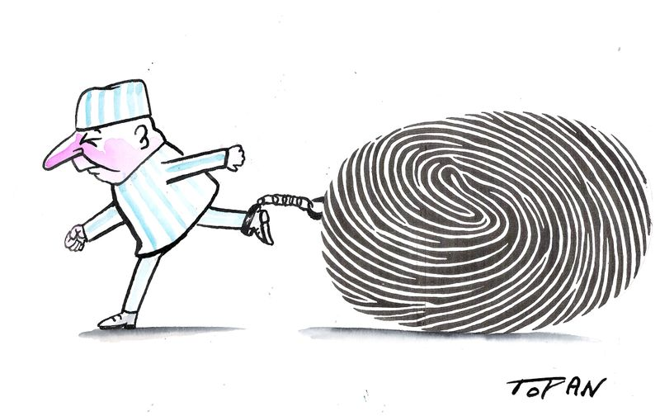
“…identities are the names we give to the different ways we are positioned by, and position ourselves in, the narratives of the past.”
(Hall, 1994, p. 394)

Slide 31
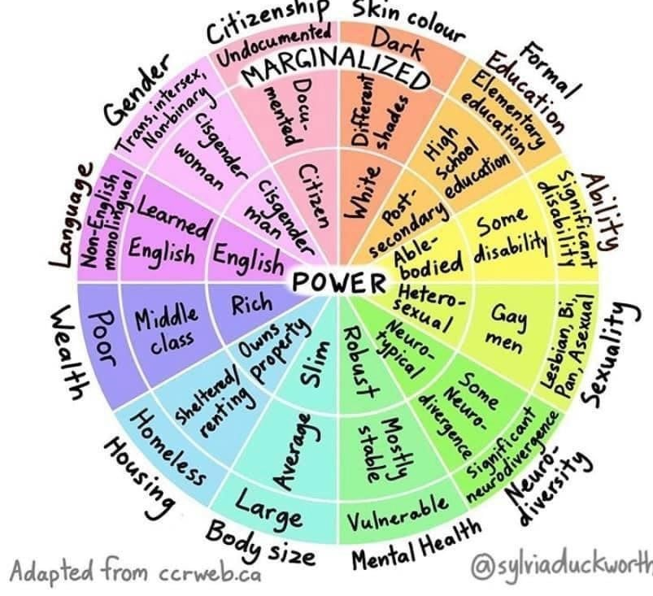
Positionality, As adopted from the MH Institute for Teaching Excellence
Intersectionality, The intersection onion as Adapted from – Edvina Bešić
Privilege, The Wheel of Power/Privilege as Adapted from ccrweb.ca
Notes:
Defining Privilege, Positionality, and intersectionality: Positionality is very much a question of understanding the following:
The perspective that you possess, which is often not explicitly acknowledged on a day-to-day basis. This includes the many and intersecting socio-cultural identities that accompany it and experiences that contributed to its formation. It is perspective that formulates many of our preferences and biases, plus it influences everything that we create, interpret and understand.
The privilege that you possess, which accrues as a result of your socio-cultural identities and the way they position you in any given context or location. Privilege is often fairly invisible since it is part of a normative and hegemonic system of relationships and forms of domination.
The power you possess as a consequence of your privilege and its operation through the system of relationships; plus the role that you play in perpetuating that power by maintaining its knowledge and discourses; be that actively or as a consequence of ignorance.

Slide 32
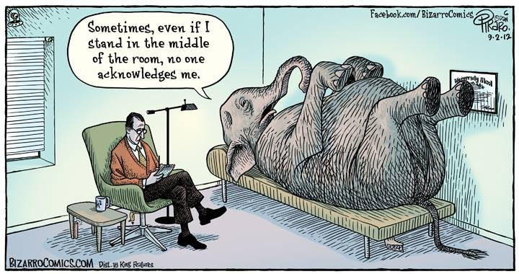
This is My Positionality: http://youtu.be/Sz3RPZeqGFk
Notes:
Chiseri-Strater (1996) argues that researchers are positioned by age, gender, ‘race’, class, nationality, sexuality, institutional affiliation, intellectual predisposition, education history, and other aspects of their personal circumstances and experiences. And yet within academia—for a long time—positionality had been like the elephant in the room, ever present but treated as invisible in the face of (problematic) positivistic notions to do with the neutrality, objectivity and universality of knowledge and its production within academic scholarship.
Reference:
Chiseri-Strater, E. (1996). Turning in upon ourselves: Positionality, subjectivity, and reflexivity in case study and ethnographic research. In Mortenson, P. & Kirsch, G. (Eds.), Ethics and representation in qualitative studies of literacy (p. 115-133). Urbana, IL: NCTE.

Slide 33

The Research Process and Positionality
What we research: What brought you to your thesis/ research idea? When did you get interest in the subject/ research question? Why is this topic specifically important to you?
How we disseminate outcomes
How we construct knowledge: Access to knowledge of the canon (literature, research methodologies, etc.), Access to knowledge of the research context (language, culture, geography, societal make up, politics, etc.), Access to and interactions with your research sample
your “insider” or “outsider” status?
Positionality Effects
How we research: How does your identity affect your perspective on the topic you are interested in studying/research?
How we relate to participants/collaborators: What power and privileges do you bring to your study?

Slide 34

Linking Positionality To Equitable WASH Research
Positionality as a tool for individuals to improve research.
Positionality speaks to structural power imbalances.
It can reveal the roots of global inequality.
Notes:
Decolonization & improving research equity must center LMIC stakeholders, bringing them to the forefront to tell their own stories, set research agendas, and receive credit
Centering requires the “yielding of power" and resources to stakeholders who are of less privileged identities due to social and geopolitical factors.⁶
Collective action is needed to distribute the power for more just WASH research.
The onus of building equity is on sector leaders, leaders of WASH organizations, funders, conference organizers, and publication boards who must reshape their operations to subvert cultures of domination and inequitable resource distribution.

Slide 35
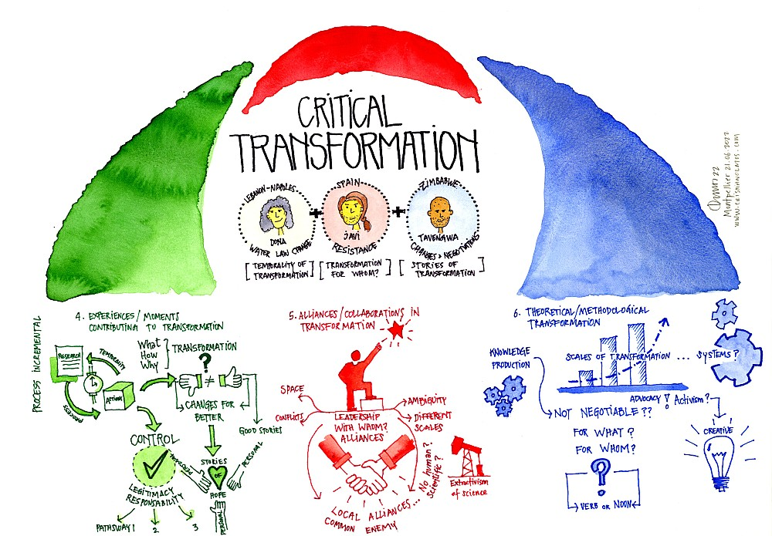
Linking Positionality To Equitable WASH Research on Climate Change Adaptation and Mitigation
Drawing by Cristian Olmos Herrera

Slide 36
“With my research I aspire to ‘situated solidarity’ with Semarang-based activists. I have much to learn from their experience and intimate/deep knowledge of how the degradation of the environment they live in is a story of social marginalization and commodification of nature. I have much to write about their refusal of uneven urbanization, and their attempts to address the water crisis in Indonesian cities for what it really is: a political, colonial and capitalist crisis.”
Excerpt from Marie’s provocation: On how a woman researcher from Europe feels when decolonising her work.
WASH Researchers and scholars should direct their efforts towards resisting “Climate Coloniality”
Notes:
We would like to problematize how we transform water research by linking it to climate change and by anchoring it into the history of colonialism, capitalism and intersectional forms of subordinations. This provocation is our way to consider the ways in which climate change lays bare the colonialism of the past and the ongoing coloniality of the present into our efforts to critically transform water research.

Slide 37
Letter to the last international development agency that rehabilitated our irrigation scheme;
Dear Donor,
As I write this letter I am aware that I might not get a reply but that will be painfully fine. In fact you may never get this letter because we don’t have your postal address, we only know your name. In case you are wondering who I am, I am the little girl Sibo, I was five the last time we saw you, and now I am ten. I thought of writing to update you about the submersible pumps you gave us. They looked beautiful when you orphaned them during an event you termed, handover and commissioning, it was a literal handover because, for the greater part, the developments were only and only in your hands, and we were reduced to endorsing spectators save for the few who were required for labour- manual labour.
Excerpt from A vignette: On how transformation can become a way to perpetuate structural inequalities, triggering reflections on what is being transformed, by whom, for whom and to what end?
WASH Researchers and scholars must consider power asymmetries and take heed of the plurality of ways to understand and perform transformation in Climate Change Adaptation and Mitigation
Notes:
Participatory approaches have aspired to facilitate empowerment of marginalized groups and individuals in governance spaces. However, these approaches have also been mobilized to serve dominant agendas, including in water governance arenas. The (mis)use of a concept/term like ‘participation’ has therefore played a double role: as a tool to underpin hegemonic powers and to gain legitimacy. This phenomenon of a “loss of critical nouns”, in Boaventura De Sousa Santos’s words, could become the fate of “transformation” if we don’t take heed of the plurality of ways to understand and perform transformation.

Slide 38
“I feel the urge to acknowledge and emphasize how all my work is the product of a collective work and engagement, of many collaborations and exchanges, many hearts, eyes and brains coming together and engaging in conversations around water…”
Excerpt from A vignette: On how On how academia can hinder collective work
WASH Researchers and scholars must challenge a neoliberal and western-knowledge oriented academia that limits what we can do and how we can engage with different actors and knowledges
Notes:
We want an academia that creates spaces and moments for more open and meaningful engagements with people (activists, practitioners, policy makers, citizens). We want to conduct research based on the collective construction of knowledge guided by the interests-needs of local people, yet this is difficult as we still have to comply with a strict timeline based on the production of papers and following what is considered as “legitimate” scientific practice. We want an academia that acknowledges that these issues do not affect all of us in an equal manner, thus preserving structural problematiques, and that engenders the creation of spaces to thematise, resist and change them. Ultimately we want an academia that allows us to dream of different ways of doing research without dealing with precarious conditions ourselves. It follows that our demand for an emancipatory and structural transformation of how we see and govern water implicates a transformation of our own socio-cultural and material relations, which necessarily includes the academic spaces we construct.

Slide 39
Key Messages
How can your research be transformed to transform the world?
Positionality is differentiated, as it shifts across space-time, is dependent on the scale at which it is examined, and is determined by the interplay of fluid relationships of power, physical locations and assumed roles and/or identities.
Positionality as a concept is not only critical for the researcher, but can also be used to understand how the researched are dynamically located in a complex web of scaled and place-based (but not place-bound) interactions.
We need a form of reflexivity that gives us a fuller understanding of the researcher, the researched and the research context, including comprehending the in-between nature of the relationships within and among the above.
All knowledge is specific, limited, partial and situated; i.e., produced in specific circumstances that shape it in discrete and particular ways.
Consequently, it is important to make known one’s positionality, in relation to the researched and their context, plus to limit one’s “truth claims” versus attempting to make grand statements with supposed universal applicability.

Slide 40
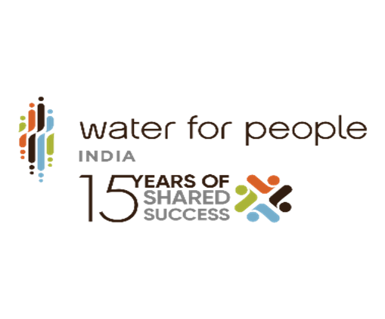
Section 3: Reimagining data for systems change
Sujata Tripathy

Slide 41



Some of the major challenges !!
08 - Most of this information is lost in the lifecycle of the program and remains invisible to the state or the ecosystem of development programs.
01 - Lack of visibility regarding any prior knowledge of the participants.
08
02
02 - Tracking the attendance manually.
01
07 - Effective reporting to programs as they find it challenging to view the participation data happening across locations.
07
03
03 - Lack of accessibility to the participation data as and when required.
05
06 - Generating reports post the training as a separate activity.
06
04
04 - Most of the times, unavailability of data as to how many participants have you trained till now and on what topics.
05 - Format of sharing the content with the participants for better accessibility and usage.

Slide 42
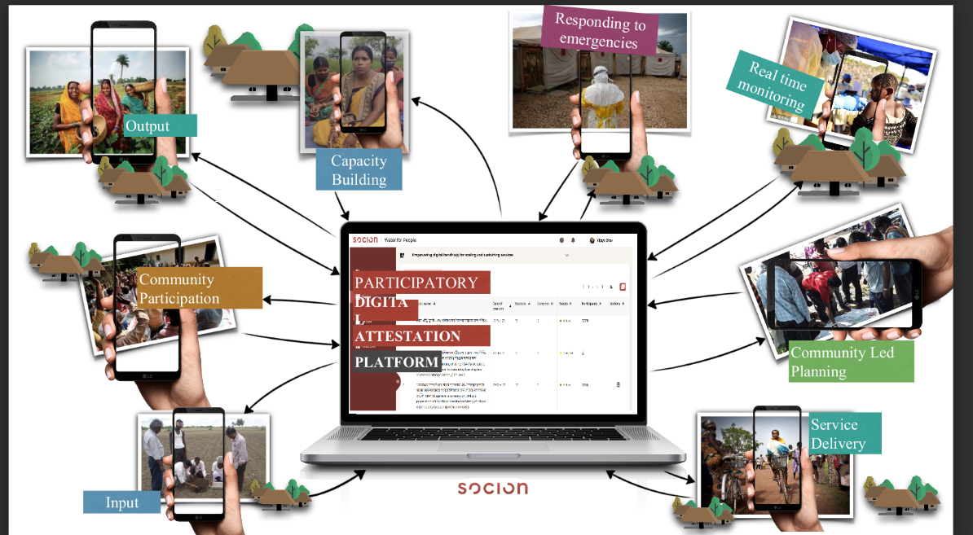
Participatory Digital Attestation platform- Capacity Building@scale model.

Slide 43






Data Reimagined- Adoption of digital technology platforms.
01
02
03
04
05
06
Increases transparency and improving program execution with trusted data.
Digital solutions for the service providers, increases the overall governance and participation.
State governments, leveraging data from one program to re-use in other programs, across departments.
The data could be related to plans that need to be made, performance of service providers or about service levels themselves
The programs get useful, verifiable & real time data on who was trained, on what, where and on what is happening post the training.
Enhance community engagement, making it more effective, visible and measurable.

Slide 44
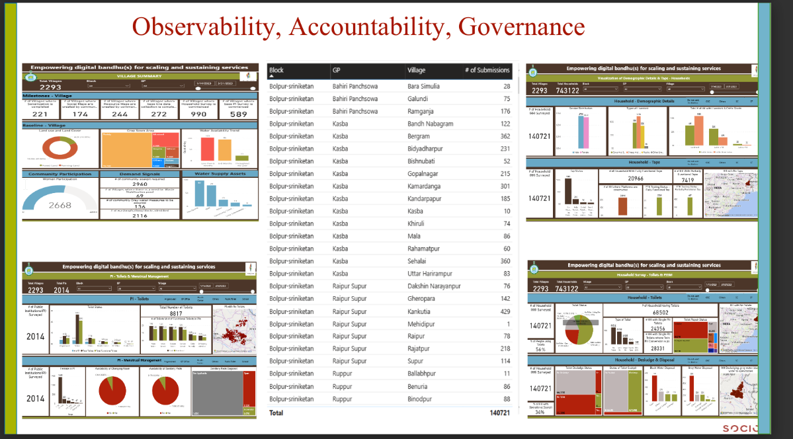
Data Reimagined- Impact.
Generate trusted data that supports decision making and facilitates convergence.
Enriches social-accountability.
Strengthens governance.
Demonstrating/Sharing of the model dashboard reflecting digital data platform used for supporting the State/District Administration for implementation of the flagship program-JJM and SBM 2.

Slide 45
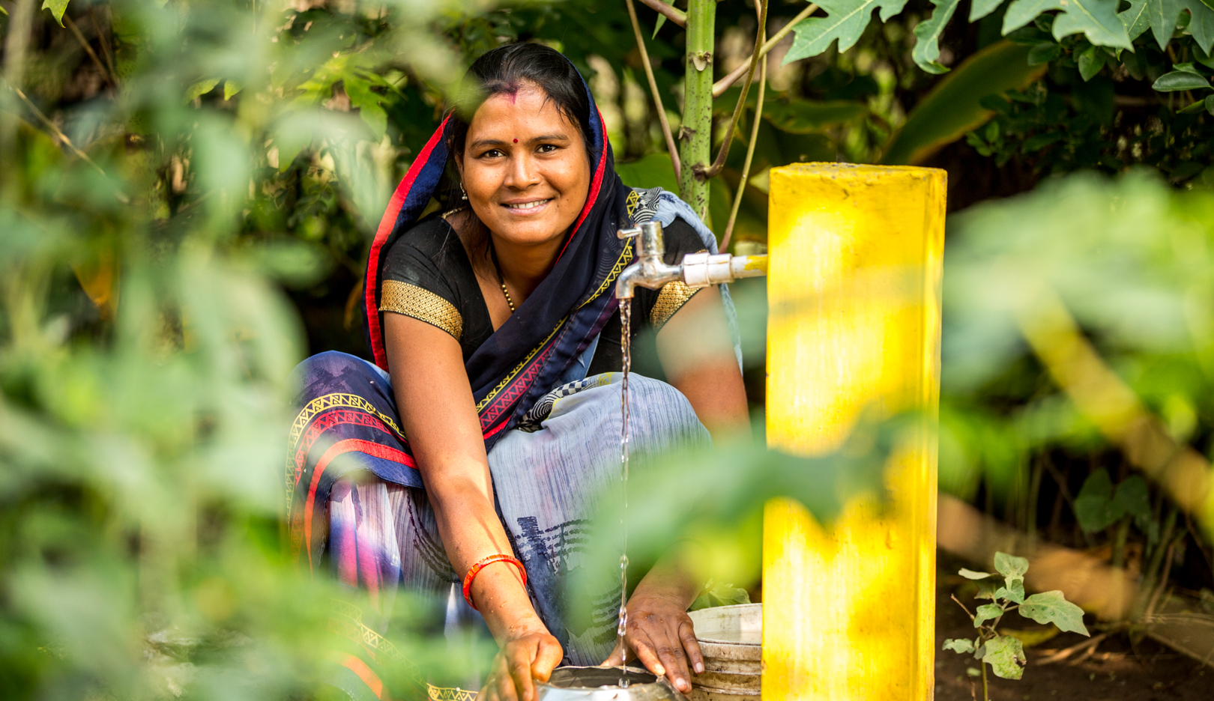
Thank You!

Slide 46
WORLD CAFÉ QUESTIONS
1. How does equity in WaSH research and practice influence the attainment of SDG6?
2. What transformations do I want to see in terms of equity? How do they look like in institutional system’s strengthening?

Slide 47
TO TAKE HOME
AND REFLECT ON…
How much of this is am I able to influence?
THANK YOU!

Slide 48
Section 2
Positionality to increase equity

Slide 49
My positionality statement
I am a African woman born and raised in Nairobi, Kenya. I hold a Msc. On Education for Sustainability from London South Bank University. As a Water Governance Specialist I understand that the disciplines in which I have been trained have significant histories (continuing to the present) as tools of colonisation. I bring the experience of both my cultural heritage and my professional development to my research.
Towards bringing a more comprehensive view to my research, I recognize my positionality is shaped by my privilege and access to some resources, and I strive to be aware of my own biases and recognize how these may shape my research.
Notes:
Positionality statements help us become conscious of our own subjectivity in order to consider how this subjectivity might shape our work within a particular context.

Slide 50
“…identities are the names we give to the different ways we are positioned by, and position ourselves in, the narratives of the past.”
(Hall, 1994, p. 394)

Slide 51
Privilege, The Wheel of Power/Privilege as Adapted from ccrweb.ca
Intersectionality, The intersection onion as Adapted from – Edvina Bešić
Positionality, As adopted from the MH Institute for Teaching Excellence
Notes:
Defining Privilege, Positionality, and intersectionality: Positionality is very much a question of understanding the following:
The perspective that you possess, which is often not explicitly acknowledged on a day-to-day basis. This includes the many and intersecting socio-cultural identities that accompany it and experiences that contributed to its formation. It is perspective that formulates many of our preferences and biases, plus it influences everything that we create, interpret and understand.
The privilege that you possess, which accrues as a result of your socio-cultural identities and the way they position you in any given context or location. Privilege is often fairly invisible since it is part of a normative and hegemonic system of relationships and forms of domination.
The power you possess as a consequence of your privilege and its operation through the system of relationships; plus the role that you play in perpetuating that power by maintaining its knowledge and discourses; be that actively or as a consequence of ignorance.

Slide 52
This is My Positionality: http://youtu.be/Sz3RPZeqGFk
Notes:
Chiseri-Strater (1996) argues that researchers are positioned by age, gender, ‘race’, class, nationality, sexuality, institutional affiliation, intellectual predisposition, education history, and other aspects of their personal circumstances and experiences. And yet within academia—for a long time—positionality had been like the elephant in the room, ever present but treated as invisible in the face of (problematic) positivistic notions to do with the neutrality, objectivity and universality of knowledge and its production within academic scholarship.
Reference:
Chiseri-Strater, E. (1996). Turning in upon ourselves: Positionality, subjectivity, and reflexivity in case study and ethnographic research. In Mortenson, P. & Kirsch, G. (Eds.), Ethics and representation in qualitative studies of literacy (p. 115-133). Urbana, IL: NCTE.

Slide 53
The research process and positionality
How we disseminate outcomes
What we research: What brought you to your thesis/ research idea? When did you get interest in the subject/ research question? Why is this topic specifically important to you?
How we construct knowledge:
Access to knowledge of the canon (literature, research methodologies, etc.), Access to knowledge of the research context (language, culture, geography, societal make up, politics, etc.), Access to and interactions with your research sample your “insider” or “outsider” status?
Positionality Effects
How we research: How does your identity affect your perspective on the topic you are interested in studying/research?
How we relate to participants/collaborators: What power and privileges do you bring to
your study?

Slide 54
Linking positionality to equitable
WASH research
Positionality as a tool for individuals to improve research.
Positionality speaks to structural
power imbalances.
It can reveal the roots of
global inequality.
Notes:
Decolonization & improving research equity must center LMIC stakeholders, bringing them to the forefront to tell their own stories, set research agendas, and receive credit
Centering requires the “yielding of power" and resources to stakeholders who are of less privileged identities due to social and geopolitical factors.⁶
Collective action is needed to distribute the power for more just WASH research.
The onus of building equity is on sector leaders, leaders of WASH organizations, funders, conference organizers, and publication boards who must reshape their operations to subvert cultures of domination and inequitable resource distribution.

Slide 55
Linking positionality To equitable WASH research on climate change adaptation and mitigation
Drawing by Cristian Olmos Herrera

Slide 56
“With my research I aspire to ‘situated solidarity’ with Semarang-based activists. I have much to learn from their experience and intimate/deep knowledge of how the degradation of the environment they live in is a story of social marginalization and commodification of nature. I have much to write about their refusal of uneven urbanization, and their attempts to address the water crisis in Indonesian cities for what it really is: a political, colonial and capitalist crisis.”
Excerpt from Marie’s provocation:
On how a woman researcher from Europe feels when decolonising her work.
WASH Researchers and scholars should direct their efforts towards resisting “Climate Coloniality”
Notes:
We would like to problematize how we transform water research by linking it to climate change and by anchoring it into the history of colonialism, capitalism and intersectional forms of subordinations. This provocation is our way to consider the ways in which climate change lays bare the colonialism of the past and the ongoing coloniality of the present into our efforts to critically transform water research.

Slide 57
“Dear Donor,
As I write this letter I am aware that I might not get a reply but that will be painfully fine. In fact you may never get this letter because we don’t have your postal address, we only know your name. In case you are wondering who I am, I am the little girl Sibo, I was five the last time we saw you, and now I am ten. I thought of writing to update you about the submersible pumps you gave us. They looked beautiful when you orphaned them during an event you termed, handover and commissioning, it was a literal handover because, for the greater part, the developments were only and only in your hands, and we were reduced to endorsing spectators save for the few who were required for labour- manual labour.
.”
Letter to the last international development agency that rehabilitated our irrigation scheme;
WASH Researchers and scholars must consider power asymmetries and take heed of the plurality of ways to understand and perform transformation in Climate Change Adaptation and Mitigation
Excerpt from A vignette:
On how transformation can become a way to perpetuate structural inequalities, triggering reflections on what is being transformed, by whom, for whom and to what end?
Notes:
We would like to problematize how we transform water research by linking it to climate change and by anchoring it into the history of colonialism, capitalism and intersectional forms of subordinations. This provocation is our way to consider the ways in which climate change lays bare the colonialism of the past and the ongoing coloniality of the present into our efforts to critically transform water research.

Slide 58
“I feel the urge to acknowledge and emphasize how all my work is the product of a collective work and engagement, of many collaborations and exchanges, many hearts, eyes and brains coming together and engaging in conversations around water.”
WASH Researchers and scholars must challenge a neoliberal and western-knowledge oriented academia that limits what we can do and how we can engage with different actors and knowledges
Excerpt from A vignette:
On how academia can hinder collective work
Notes:
We want an academia that creates spaces and moments for more open and meaningful engagements with people (activists, practitioners, policy makers, citizens). We want to conduct research based on the collective construction of knowledge guided by the interests-needs of local people, yet this is difficult as we still have to comply with a strict timeline based on the production of papers and following what is considered as “legitimate” scientific practice. We want an academia that acknowledges that these issues do not affect all of us in an equal manner, thus preserving structural problematiques, and that engenders the creation of spaces to thematise, resist and change them. Ultimately we want an academia that allows us to dream of different ways of doing research without dealing with precarious conditions ourselves. It follows that our demand for an emancipatory and structural transformation of how we see and govern water implicates a transformation of our own socio-cultural and material relations, which necessarily includes the academic spaces we construct.

Slide 59
Key messages (1)
We need a form of reflexivity that gives us a fuller understanding of the researcher, the researched and the research context, including comprehending the in-between nature of the relationships within and among the above.
All knowledge is specific, limited, partial and situated; i.e., produced in specific circumstances that shape it in discrete and particular ways.
Consequently, it is important to make known one’s positionality, in relation to the researched and their context, plus to limit one’s “truth claims” versus attempting to make grand statements with supposed universal applicability.

Slide 60
Key messages (2)
Positionality is differentiated, as it shifts across space-time, is dependent on the scale at which it is examined, and is determined by the interplay of fluid relationships of power, physical locations and assumed roles and/or identities.
Positionality as a concept is not only critical for the researcher, but can also be used to understand how the researched are dynamically located in a complex web of scaled and place-based (but not place-bound) interactions.
How can your research be transformed to transform the world?

Slide 61
Session 3
Reimagining data for systems change

Slide 62
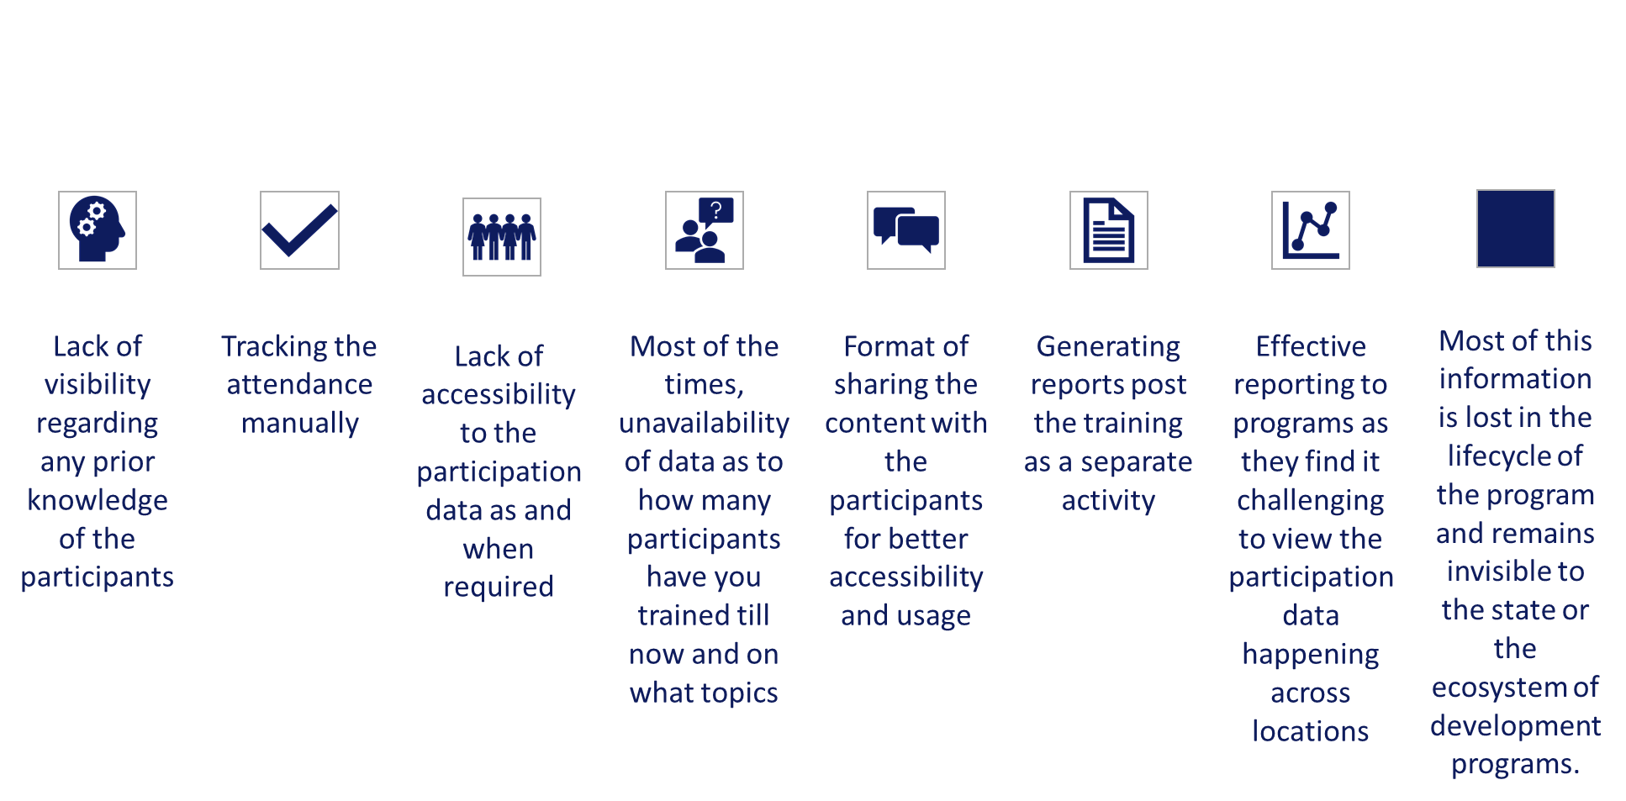
Major challenges

Slide 63
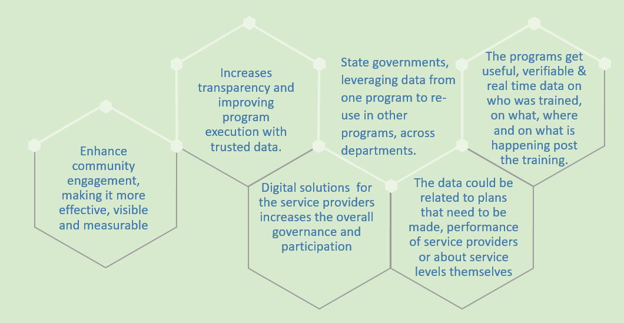
Data reimagined: adoption of digital technology platforms

Slide 64
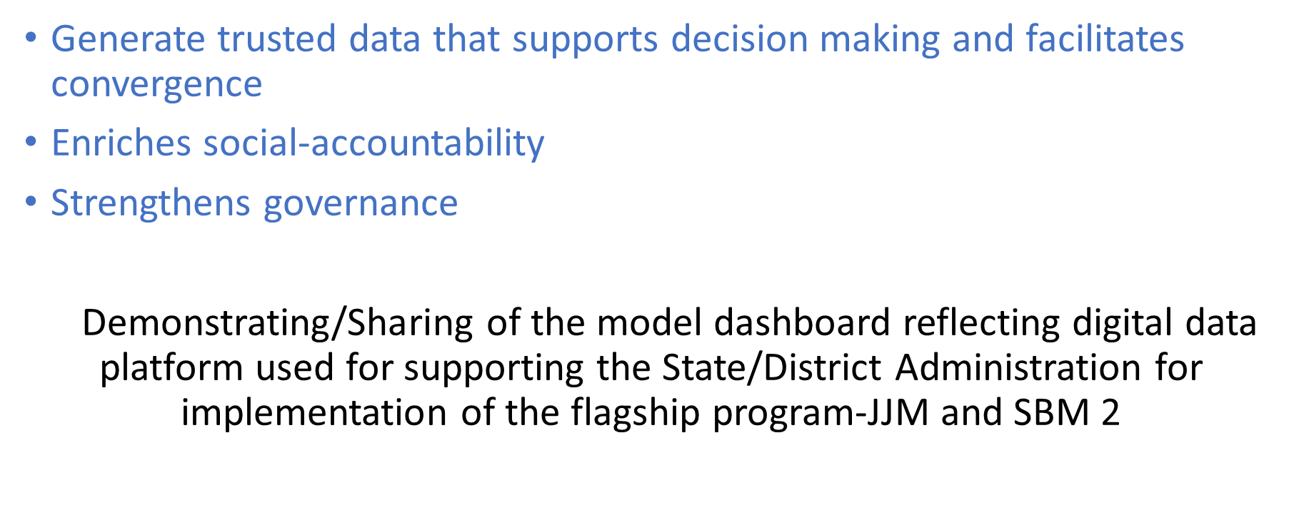
Data reimagined: impact

Slide 65

WORLD CAFÉ

Slide 66
World Café questions
How can positionality biases be balanced in the research process?
How do the issues highlighted by the research relate to your work?
How much influence do you have over these issues?
What would you do differently in your work to rectify these issues?
Notes:
On the suggested handouts by J’Anna probably instead of having answers too glaringly may be they can be more fun like her views by using vignettes stories providing hidden clues etc.
On positionality: What drives research in the water sector? How does positionality shape your approach to address water access challenges through research? What do you see with and through water?
On transformation (Sujata’s bit): What are the experiences that you would define as contributing to transformation processes or as ‘transformative’ in your research? Where was ‘water’ in this? What are some collaborations that inspire transformation? How is transformation presented and by whom? Is transformation a goal or a process?

