Slide 1
Video – previous day’s highlights
Day 2 transition

Slide 2
Welcome

Slide 3
Video – OFA

Slide 4
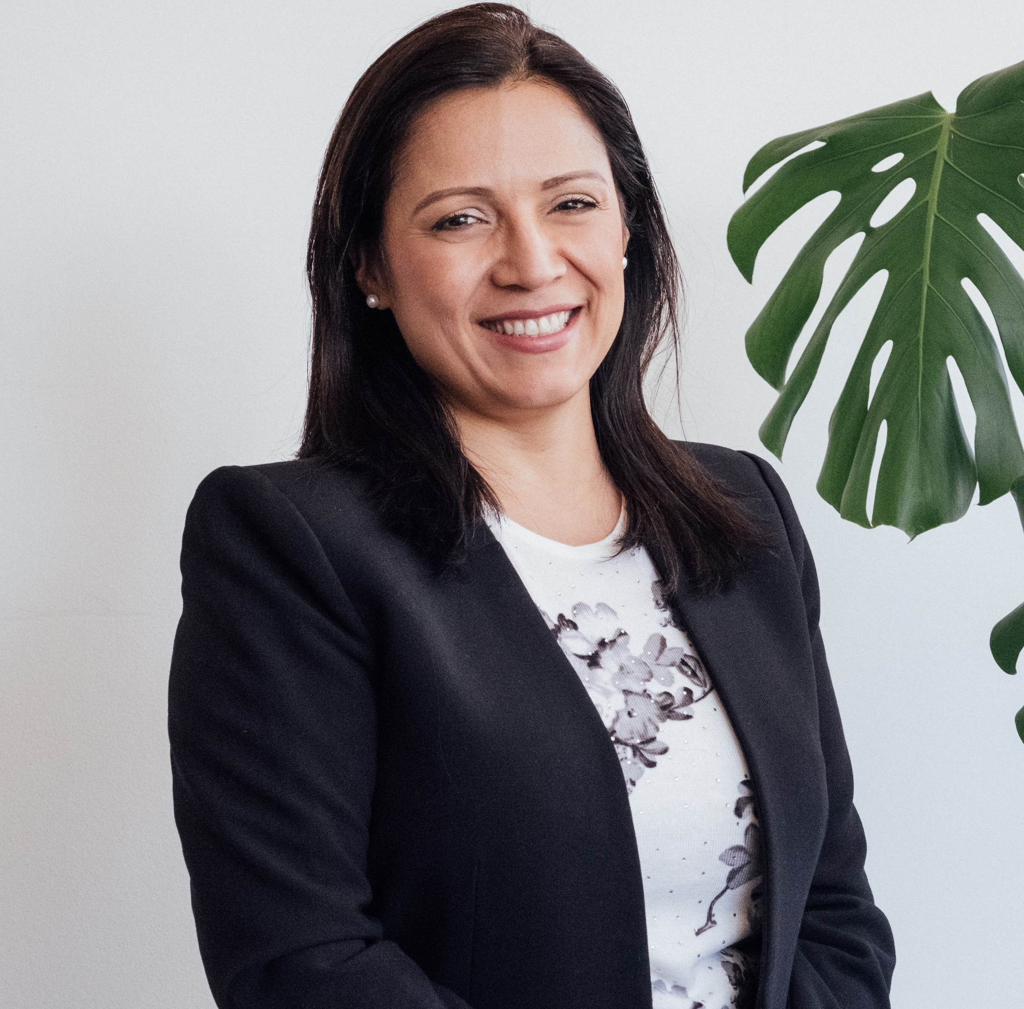
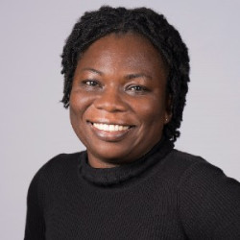
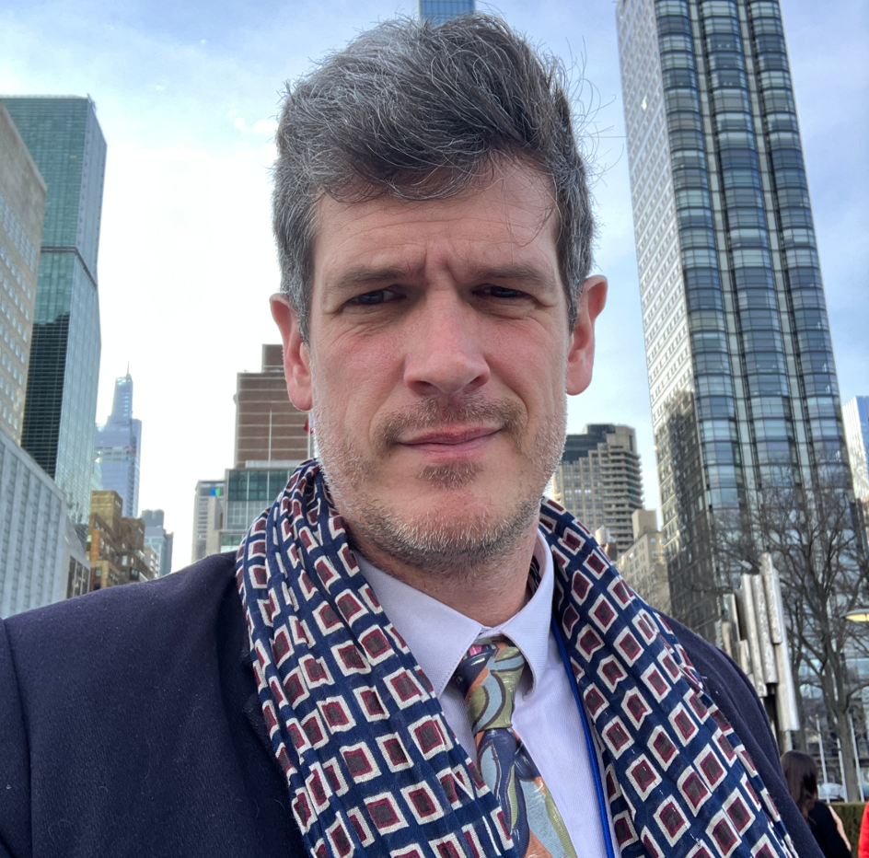
Vida Duti
IRC Ghana – co-host
Liza Rivera
Water For People - co-host
David DeArmey
Water for Good – co-host

Slide 5


Slide 6

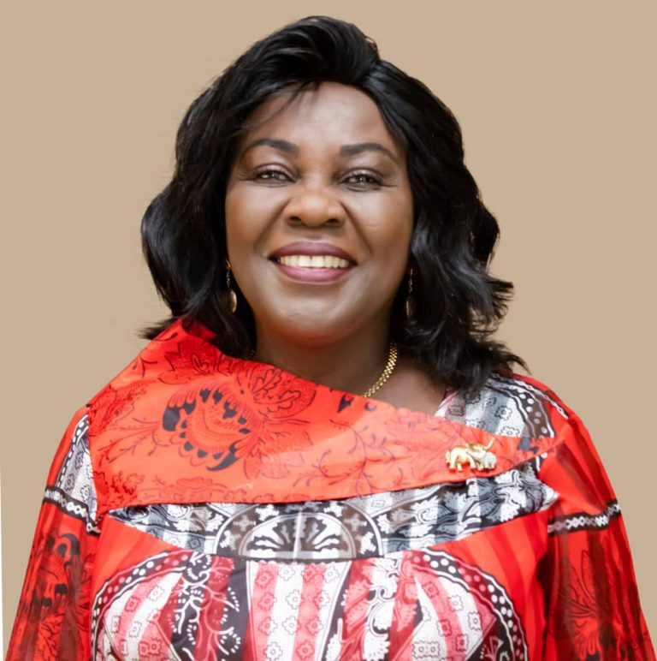
Hon. Cecilia
Abena Dapaah
Minister for Sanitation and Water Resources,
Ghana - keynote

Slide 8
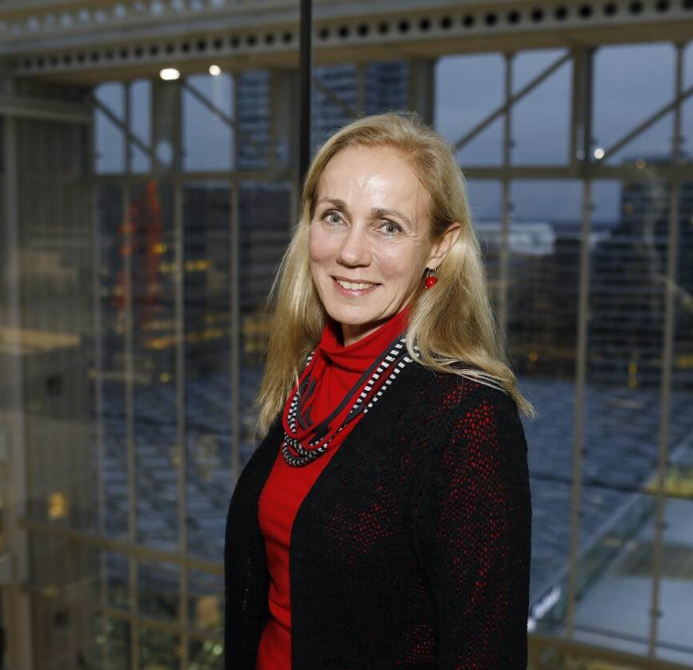
Kitty van
der Heijden
Director General, Ministry of Foreign Affairs, Government of Netherlands –
panel moderator

Slide 9
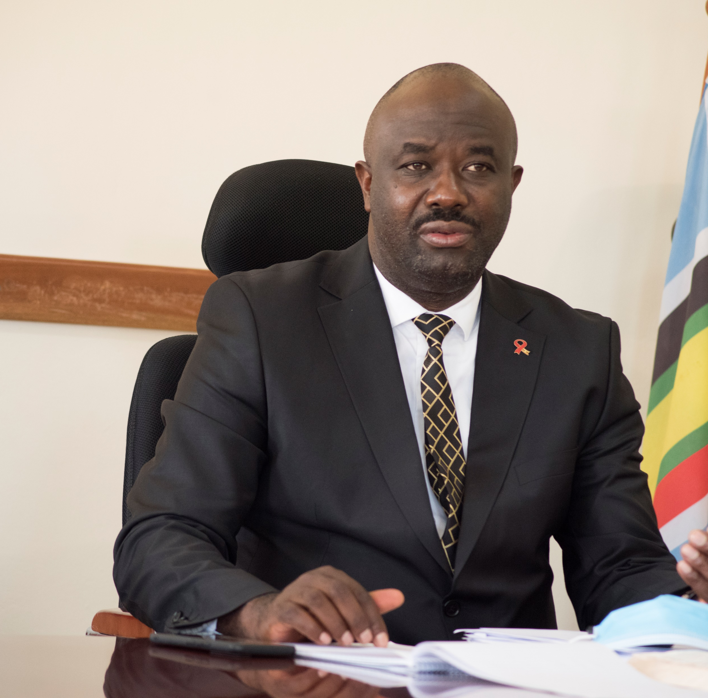
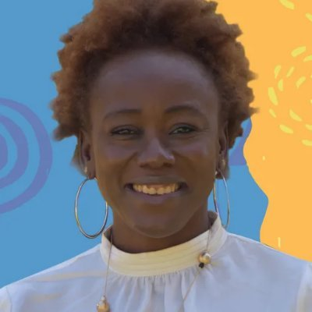
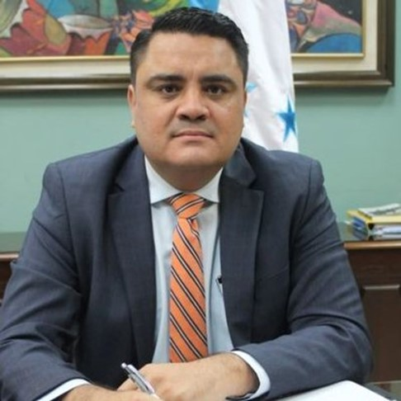
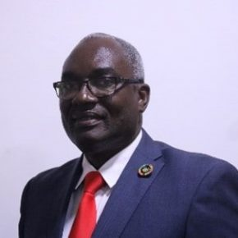
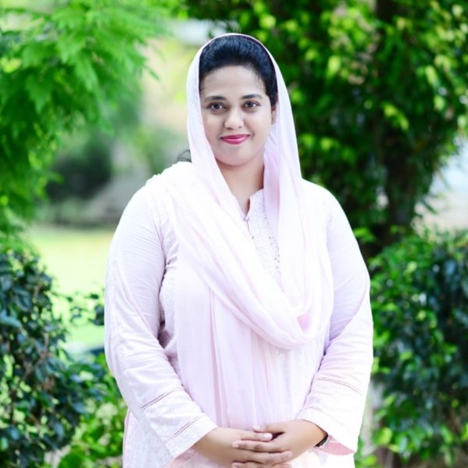
Panel
Hon. Richard Rwabuhinga
chairperson, Kabarole District Local
Government, Uganda
Dr Amaka Godfrey
Global Policy and Research Director, WaterAid
Roberto Carlos
Ramirez Alvarenga
Vice Minister of Credit and Public Investment, Finance Secretary, Republic of Honduras
Dr Kodjo Esseim Mensah-Abrampa
Director General, National Development Planning Commission, Republic of Ghana
Mary James Gill
Executive Director,
Center for Law & Justice,
Pakistan

Slide 11

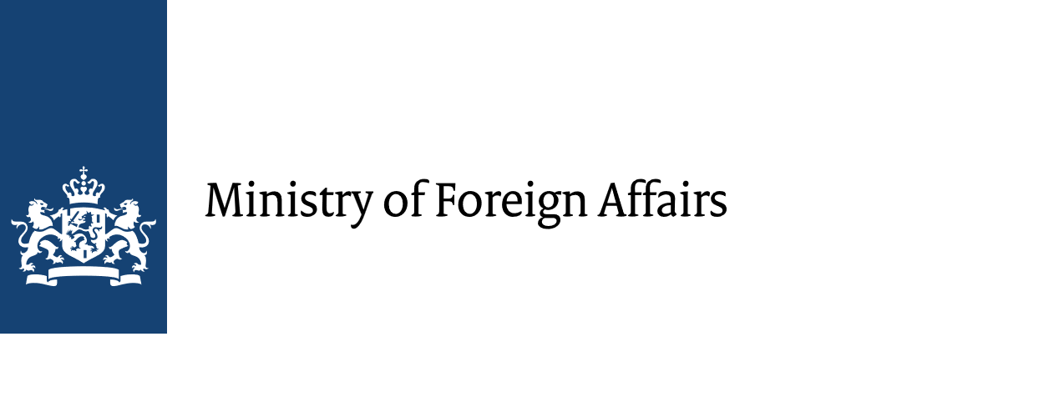














All Systems Connect 2023 is made possible thanks to the generous support of our partners including the World Health Organization and :

Slide 12
Coffee break

