Slide 1
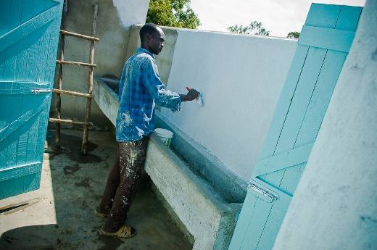
Kenya Education Sector Support Programme Funding for School WASH
Learning to Date

Slide 2
Guiding question
Given that…
...direct funding of schools for school improvements is the national policy…
…how can we make it better?

Slide 3
Sources of Data
3-year SWASH+ sustainability study (185 schools)
Monitoring and interviews in 8 schools funded by KESSP or receiving official latrine designs from SWASH+ in 2009
SWASH+ experience in direct funding of 18 schools in 2009 using the KESSP process
Roles and responsibilities assessment conducted across three districts in 2010
Review of school WASH budgets and needs in 20 schools in 2010

Slide 4
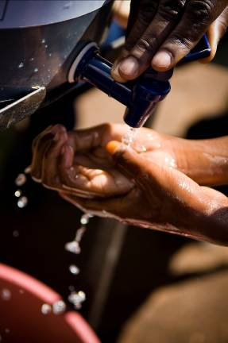
Areas of Examination
School-level budgets
2. Monitoring systems
Roles and responsibilities of actors

Slide 5
Learning on school WASH sustainability

Slide 6
Sustainability
111 Intervention Schools
(Incomplete data on 4 schools)
Potential Barriers:
Broken containers? Broken taps? No Supply Chain? Not a priority?
HW containers:
75 schools
(68% of all schools)
Potential Barriers:
No water source? Water not put in containers? Not a priority?
Water available:
61 schools
(55% of all schools)
Potential Barriers:
Stolen? Never purchased? No Budget? Not a priority?
Soap Available:
9 schools
(8% of all schools)

Slide 7
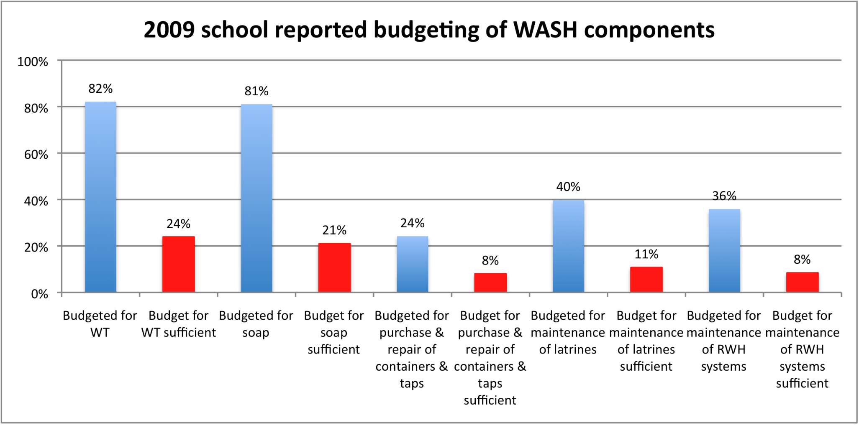
School-level WASH budgets

Slide 8
School Budgets for Yearly WASH Services
Record-keeping is spotty and inconsistent, but…
Yearly allocations are almost certainly insufficient
Schools vary widely in how much they prioritize WASH

Slide 9
School Budgets for Yearly WASH Services
Record-keeping is spotty and inconsistent, but…
Yearly allocations are clearly insufficient
Schools vary widely in how much they prioritize WASH
From a survey of 20 schools:
Head teachers claim to have spent an average of 103 Ksh per pupil for WASH costs (Almost a third of the entire FPE allocation of 370 Ksh per pupil per year). 60% of this to obtain water (hygiene and sanitation expenditures are minimal).
The range of amounts reported is large, between 2 and 263 Ksh per pupil, indicating that there is no consistent practice.

Slide 10
What Schools Actually Receive (Ksh/pupil/year)
FPE Capitation | Total per term | Total per year
Support Wages (Askaris, cooks etc) | KES 55.00 | KES 110.00
Repairs, Maintenance and Improvements | KES 60.00 | KES 120.00
Activity (Drama and sports festivals etc) | KES 22.00 | KES 44.00
Quality Assurance (School based exaninations) | KES 15.00 | KES 30.00
Local transport and travelling | KES 15.00 | KES 30.00
Electricity, water and conservancy | KES 5.00 | KES 10.00
Telephone/PO Box rental/Postage | KES 10.00 | KES 20.00
Contingency | KES 3.00 | KES 6.00
Total | KES 185.00 | KES 370.00
..and other decentralized grants (e.g. CDF or center of excellence).

Slide 11
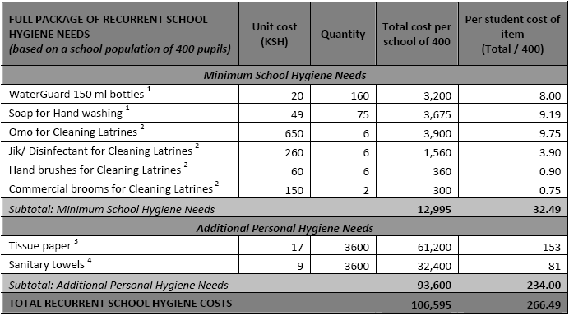
The Budget Schools Need

Slide 12
Monitoring for WASH Services – What’s Working
Infrastructure outcomes are reasonable
Most schools are getting the basic infrastructure work done
Despite some issues, schools are generally satisfied with the quality of the resulting infrastructure
One visit from DEO’s office generally happens

Slide 13
Monitoring for WASH Services – What’s not working
It’s all about infrastructure – no focus on behaviors like hygiene or inexpensive inputs like soap or water treatment
Little involvement beyond (untimely) monitoring by the Ministry of Education (e.g. no MOPHS)
DICT not budgeting for monitoring
Schools receive no report or feedback
No consistent monitoring tool used
Relevant WASH data not aggregated at higher level and shared with relevant Ministries
Policing rather than supportive (nat’l and DICT)

Slide 14
Roles and Responsibilities
District-level
No clear understanding of the process among officers, even within a given district
Other ministries uninvolved (e.g. MOPHS)
Uncritical approval of SIDPs, particularly with respect to non-infrastructure planning
Lack of budgeting

Slide 15
Roles and Responsibilities
School Level
SMC and SIC conflict a constant theme
SMCs and SICs members unable to accurately recall the process that they went through
Confusion because manual either doesn’t make it to SMCs/SICs or because some members can only read the local language
Low capacity of fundis/contractors, particularly financial
Significant management burden on head teachers

Slide 16
Core Recommendations
Overall: Move from an infrastructure to a “service provision” approach.
  (e.g. latrine ratio less important than cleanliness and latrines without hand washing can hurt)
Further decentralize monitoring and provide a budget for it – initial experience with decentralized monitoring shows promise
Ensure that monitoring systems are integrated, consistent, supportive and informative

Slide 17
Core Recommendations (cont.)
Add non up-front costs for schools into yearly FPE allocations – minimum of 33 Ksh/year
Establish a system for enhanced accountability that goes both up and down (e.g. a simple scoring system that creates space for discussion)
Aggressive training at locational/zonal and school levels (teachers, fundis, line ministries)

