Slide 1


Slide 2
Promotion of women’s entrepreneurship and leadership
The RANO WASH Project experiences in Gender and WASH systems strengthening

Slide 3

Contents
RANO WASH project overview
Entrepreneurship promotion to empower women
Leadership promotion to empower women
Key results
Notes:
My presentation will be brief, and will give you an overvie of the project, what we did to promote entrepreneurship, leadership and what key results we coud share.

Slide 4
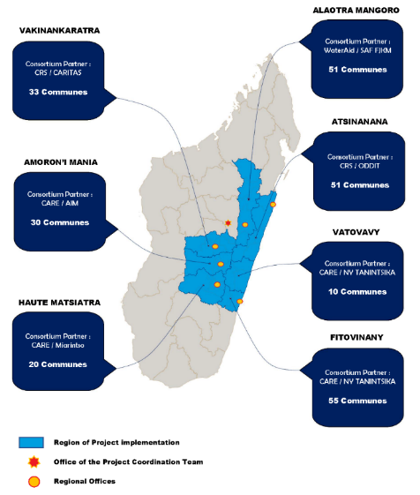
The RANO WASH Project
Rural Access to New Opportunities in Water, Sanitation, and Hygiene (RANO WASH): 2017 – 2023
  Budget: $33 million USD (USAID)
Goal: to increase equitable and sustainable access to water, sanitation and hygiene services for rural communities, to maximize impacts on health & nutrition, and preserve environment.
Three strategic objectives:
    Governance and monitoring of water and sanitation strengthened for sustainable and equitable WASH service delivery.
    Increasing and improving private-sector engagement in WASH service delivery
    Adoption and acceleration of healthy behaviors and use of WASH services
Notes:
The RANO WASH project, funde by USAID, is a project which aims to increase equitable and sustainaible access to water, sanitation and hygiene services for rural communities in Madagascar, to maximize impacts on health and nutrition and preserve environment. We work in six regions and within 250 rural municipalities.

Slide 5
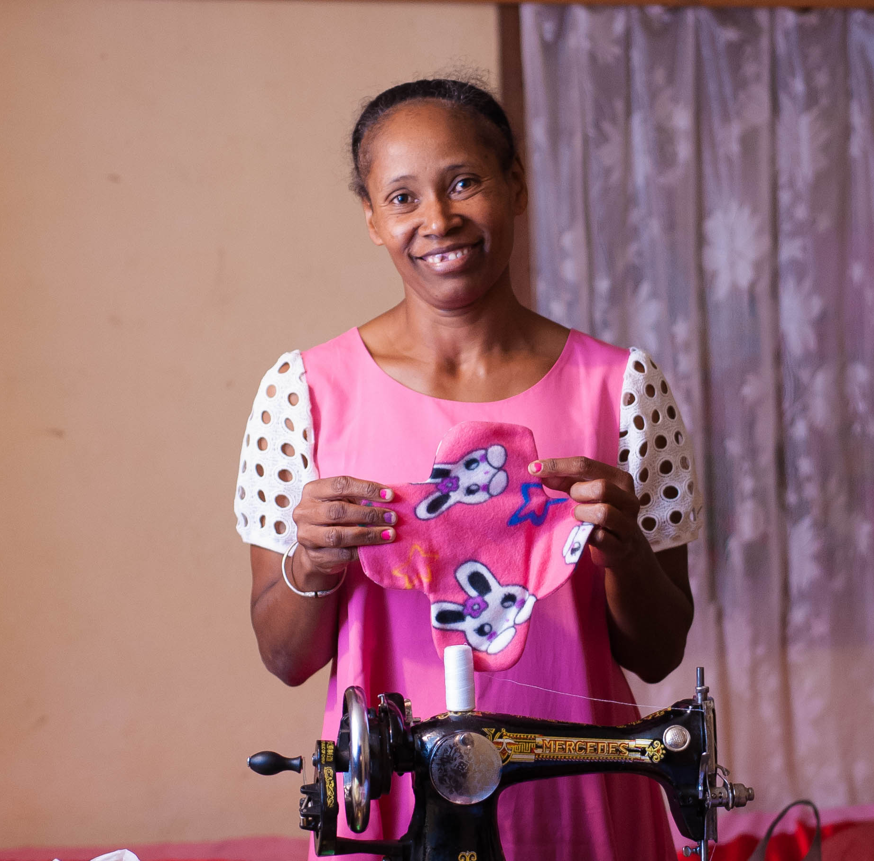
Women’s entrepreneurship promotion
Notes:
Within our gender mainstreaming strategy, we supported women to become entrepreneurs, in the WASH sector.

Slide 6
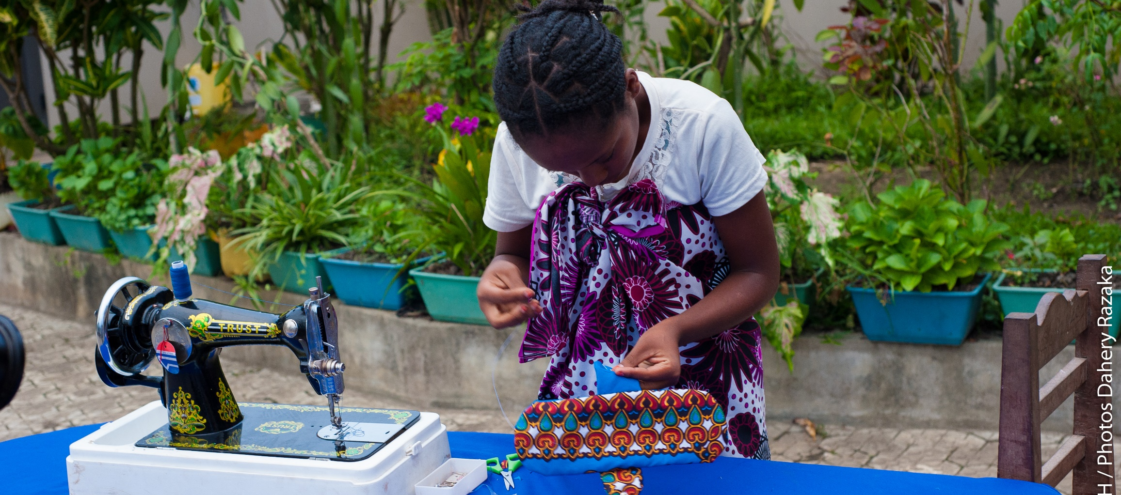
Product development: technical and business plan training
Notes:
We provided training for them. We trained local seamstresses so that they could produce washable sanitary napkins, as part of our menstrual hygiene strategy. Within our sanitation strategy, we also supported local masons, among which some were female, to develop their sanitation entreprises.

Slide 7
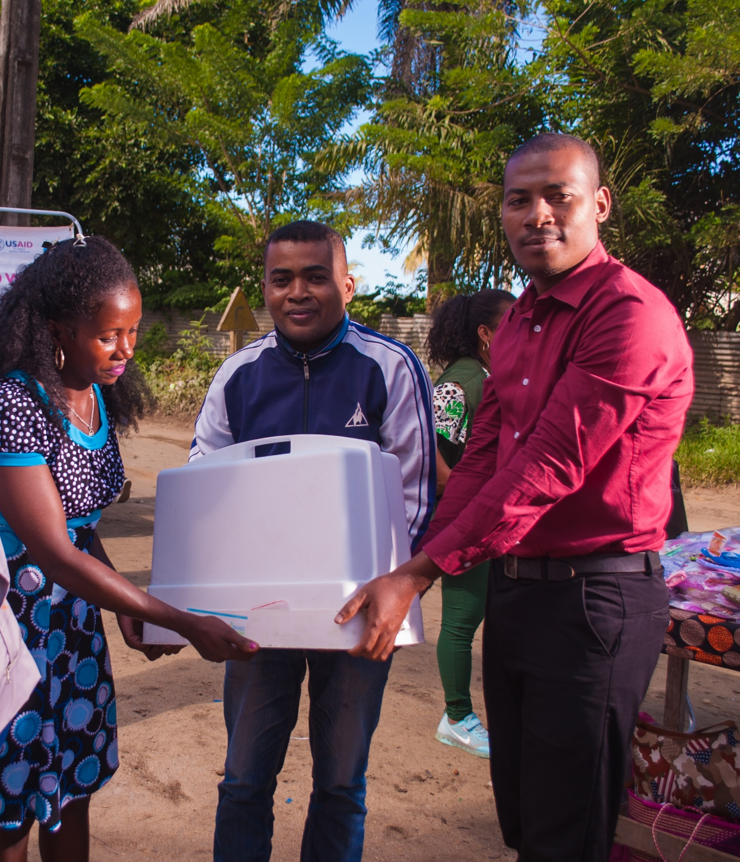
Material provision
Notes:
We also provided materials for the women entrepreneurs, as well as marketing support.

Slide 8
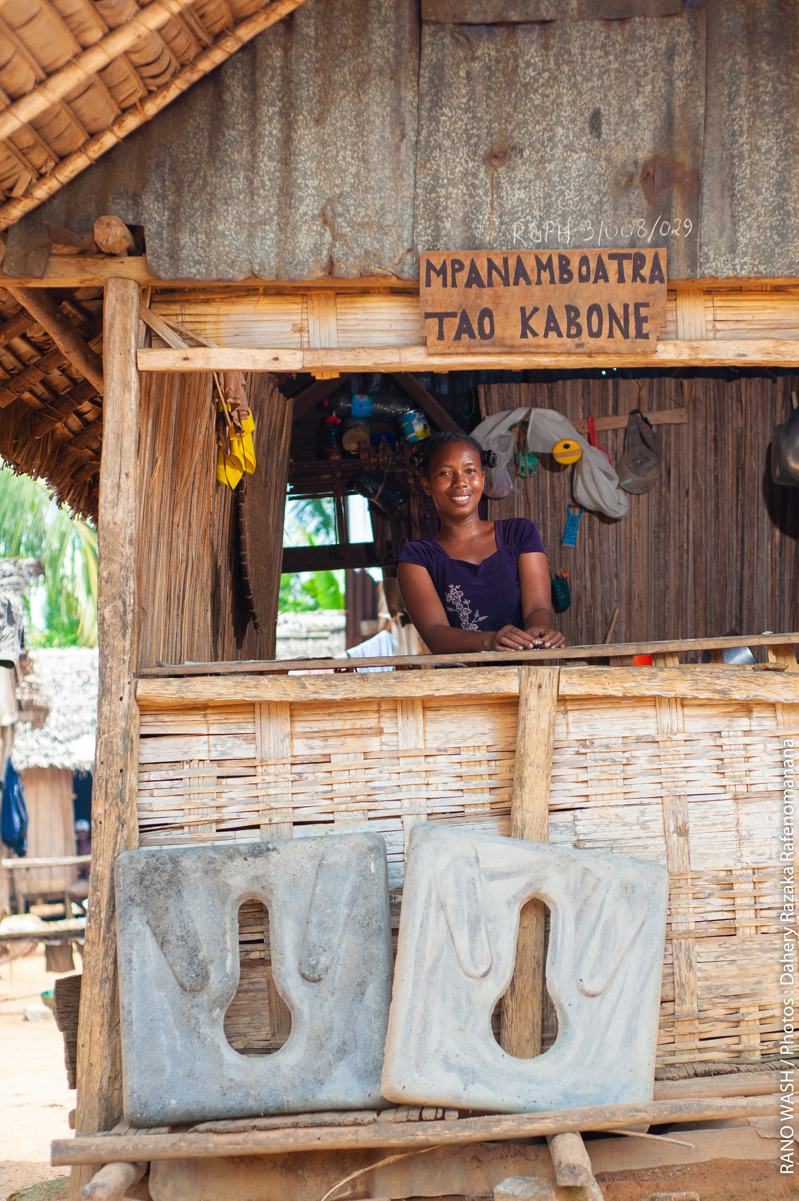
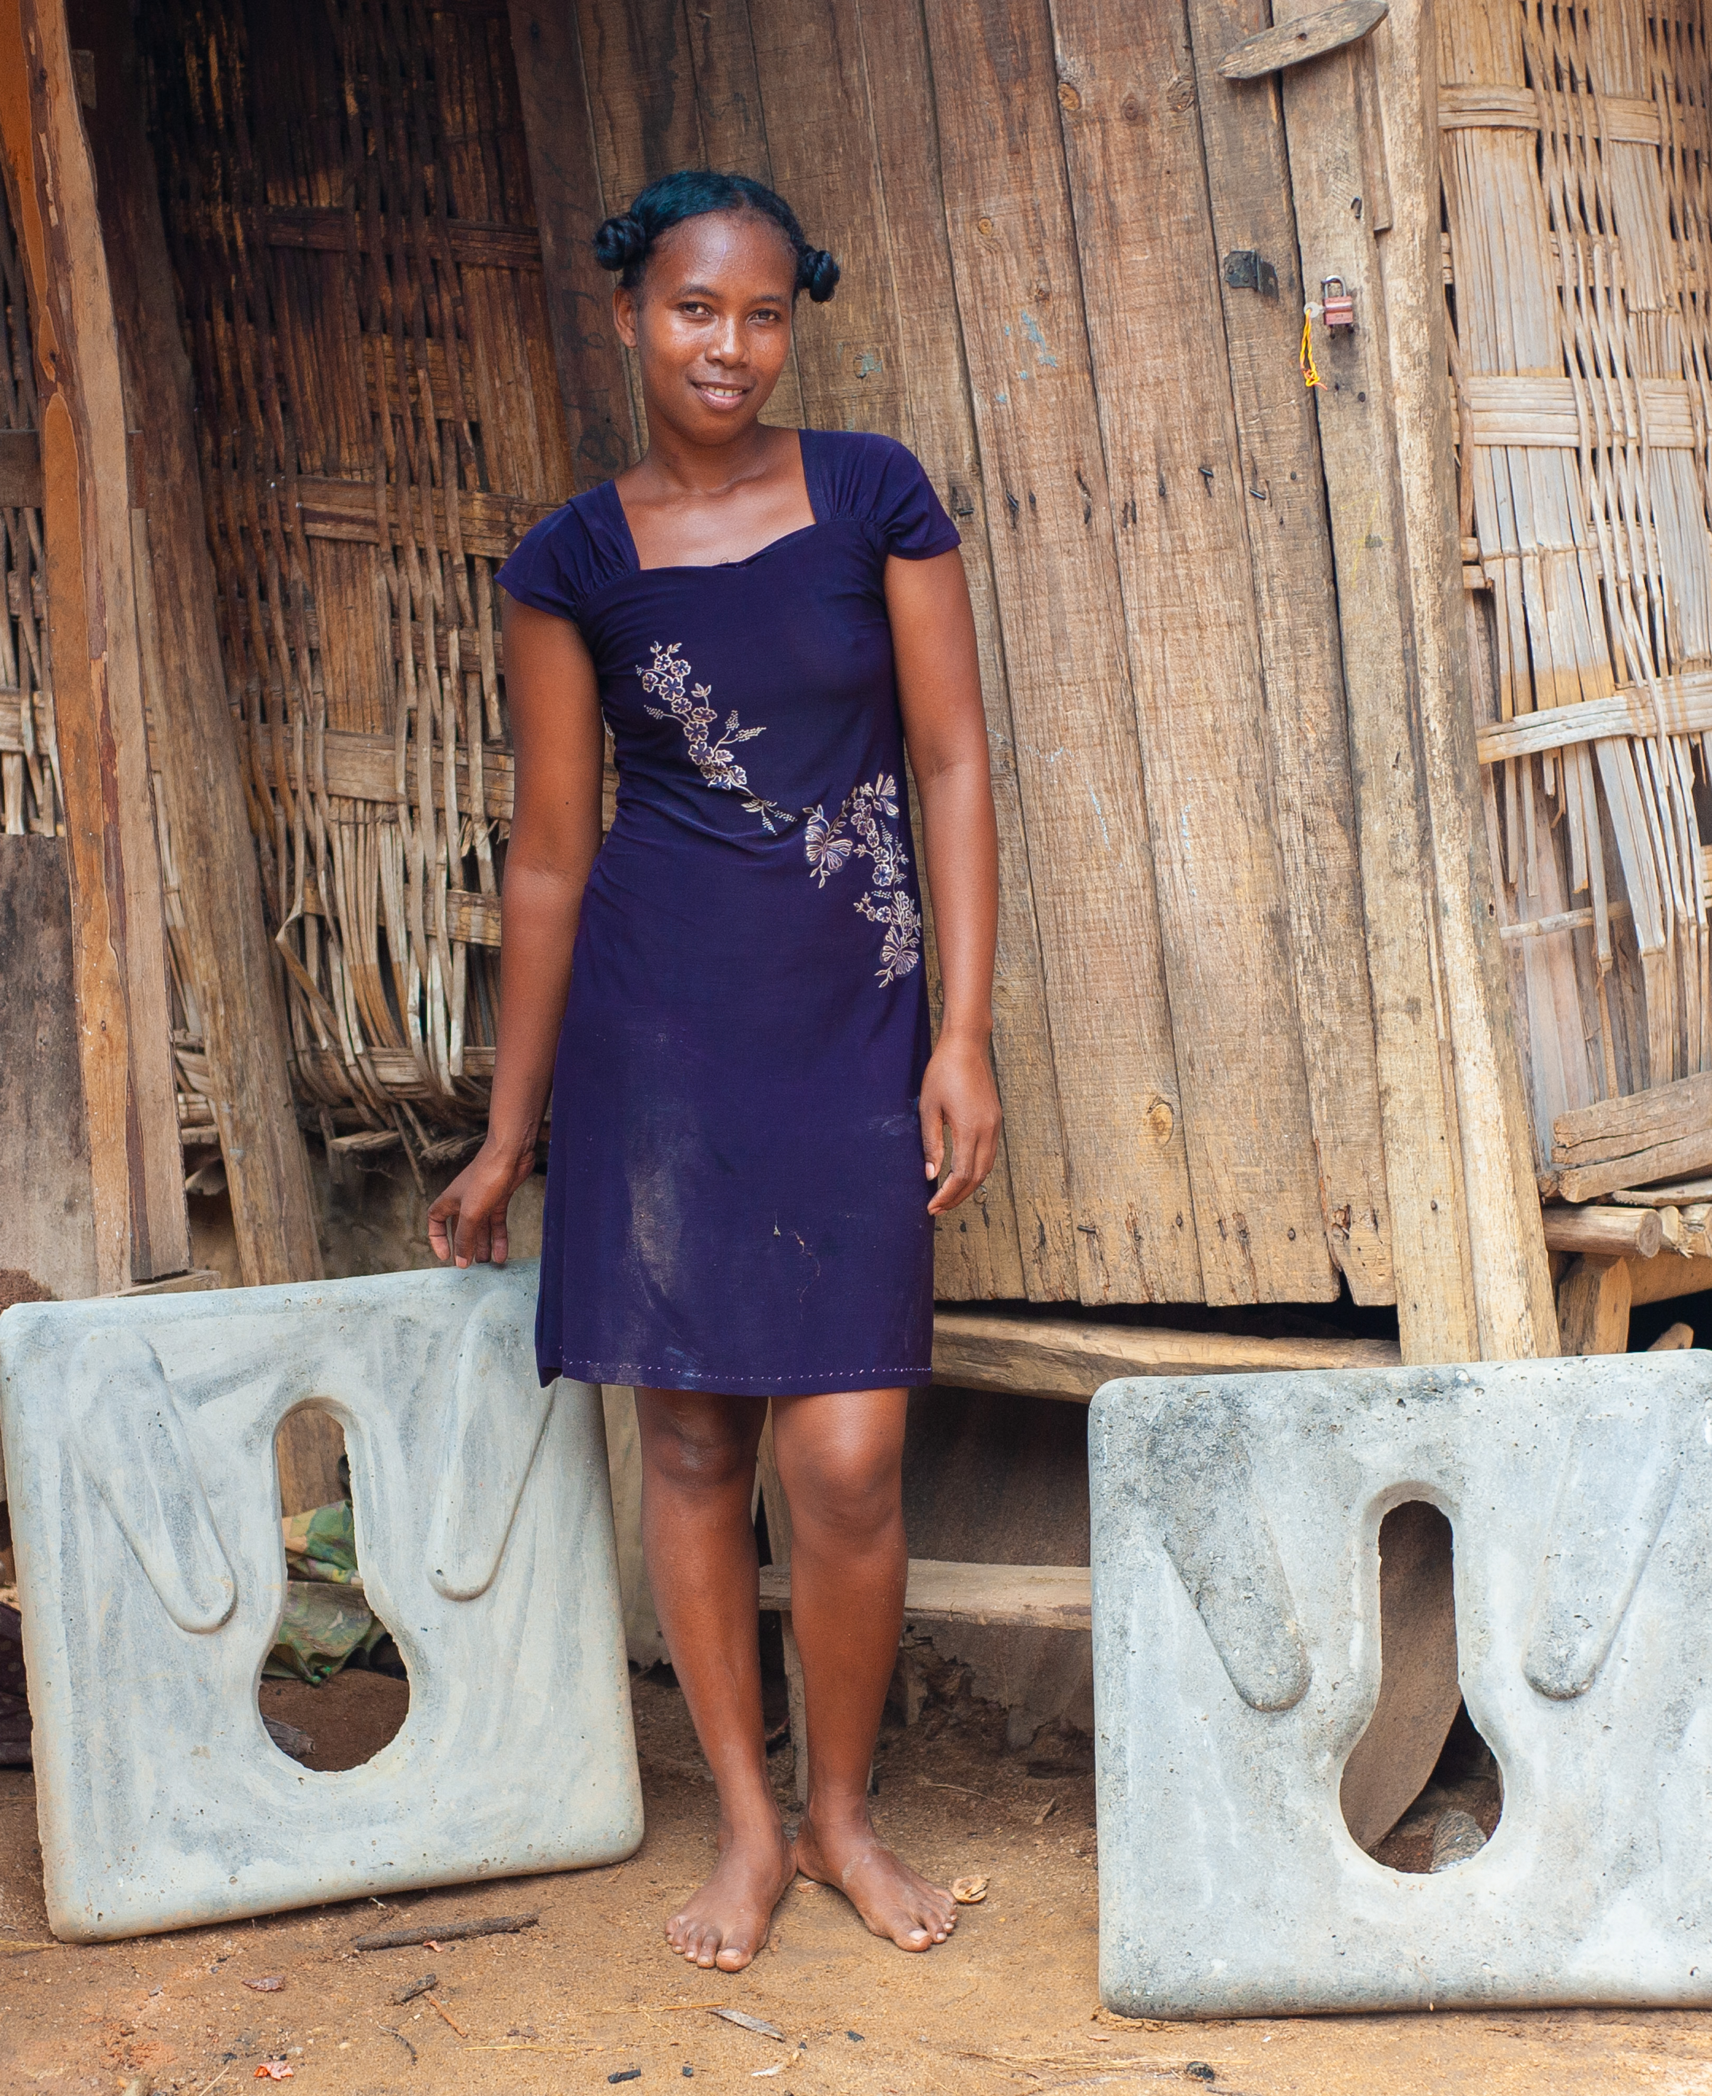
Marketing support
Notes:
We can see here one of the female local mason wo supported, who is producing sanplat slab, but also has her own little business.

Slide 9
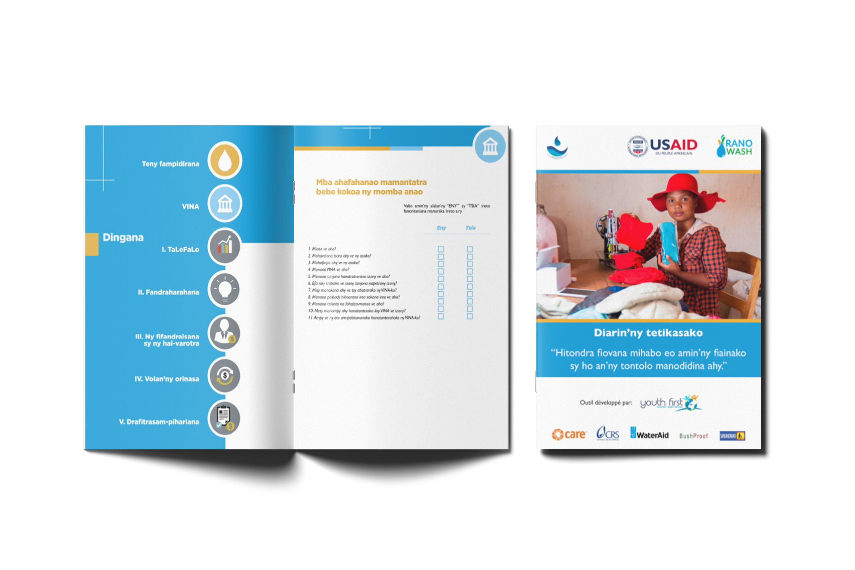
Production of guides to improve business and entrepreneurship spirit
Notes:
To strenggthen these women’s small businesses, we also developed technical guides to help them with their businesses and have entrepreneurship spirit.

Slide 10
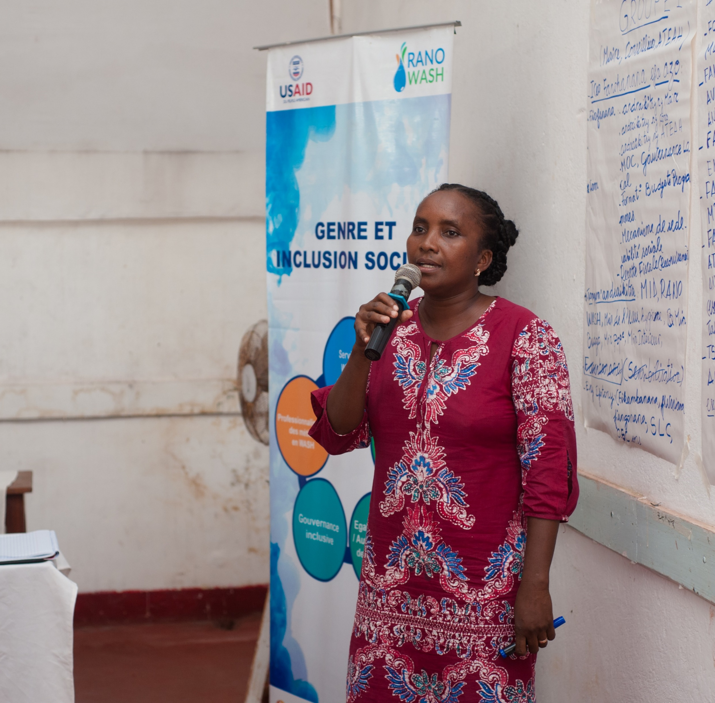
Women’s leadership promotion
Notes:
To complete our support to women’s agency and their roles as change makers, we also supported them in their leadership roles.

Slide 11
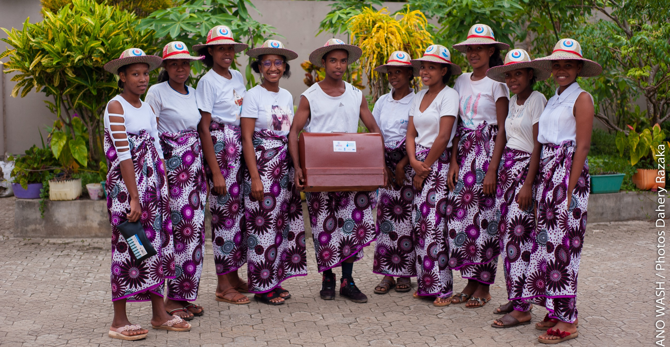
Support to VSLA as a social and financial capital
Notes:
One of our most impactful strategy is to use the VSLA or Village Savings and Loans Association model. Here in Madagascar, VSLAs are composed with at least 80% of women. VSLA provide a space for women to build their social and financial capital. Moreover, VSLA provide also a space for women to develop their leadeship skills, and build their confidence and self-esteem.

Slide 12
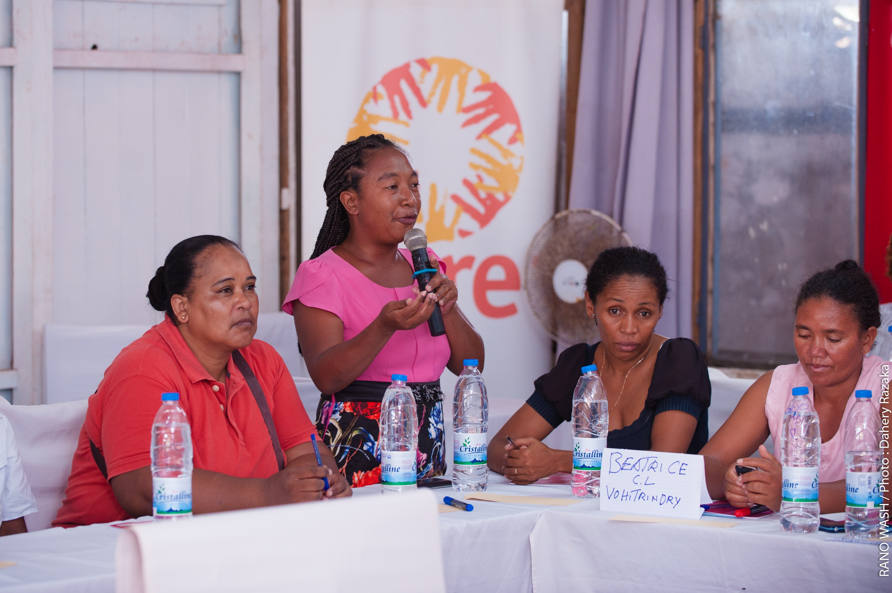
Workshops on women leadership
Notes:
We also worked with women in leadersip positions to provide themwith opportunities to discuss and share their leadership journeys, with their younger counterparts, and to appreciate how far they’ve come even in challenging situations, where being a female leader is not always seen as a good rôle in the Malagasy society. These exchanges played a vital role for these women to feel more confident, and inspired younger women to become more, and engage in more leadership positions.

Slide 13
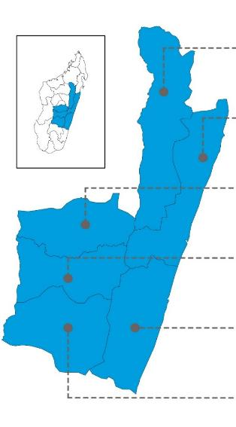
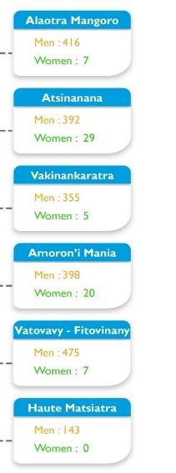
Gender Mapping
Mayors in the project's intervention municipalities
Fokontany chiefs
WASH service providers
Notes:
We also did gender mapping exercises, with the women’s positions in leadership roles, to raise awareness on waht is lef to be done, in a country such as Madagasar. We can see here that only 5% of Malagasy Mayors are women in our intervention municipalities. So much more is left to be done.

Slide 14
Key results
859 small private operators, of which 51% are women and 35% are under 35 years old.
864 people improved their income through WASH jobs created (51% women)
7,782 members of local consultation structures trained (35% women)
453 seamstresses and 22 men tailors sold 91,810 washable sanitary napkins
Gender focal points: 177, including 112 men and 65 women
Notes:
So, what can we share as key results?
We helped small private operators, among which a half were women and a third were under 35 years old. We need women to participate fully in the economic space if we want them to play a more important rôle. We also created jobs for women, ensuring financial indépendance. We supported women to participate in local consultation spaces, which is very important id we want policies to benefit women. We also provided opportunities for women and girls to be able to manage their period appropriately, which is a basic right. Finally, we also supported men and women as gender focal points, who will continue to raise awareness and provide opporunities to women and girls to participate fully in social, economical and political life, thus promoting lifelong changes in systems.

Slide 15


Resources
Please visit the project’s website at
http://www.ranowash.org/
Notes:
To know more about the project and its resources, please visit us at www.ranowash.org

