Slide 1
WASH and Food Security news & resources : a starter
RNTC Multimedia Journalism & Food Security Course presentation
  01 April 2015

Slide 2
Content
  How are WASH & Food Security linked
  International WASH news services
  IRC News and Information Resources
  Key international organisations
  Key WASH resources

Slide 3
  How are WASH & Food Security linked
Economic
Competing water use : Water – Food – Energy Nexus
Water: Too much, too little, too dirty
Virtual water trade
Fertilizer and biogas from (human) waste
Health
Environmental enteropathy + food hygiene Malnutrition

Slide 4
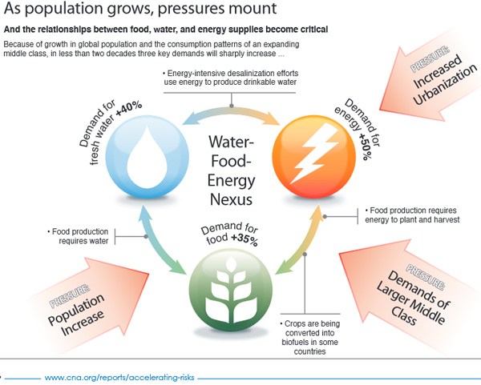
Water – Food – Energy Nexus

Slide 5
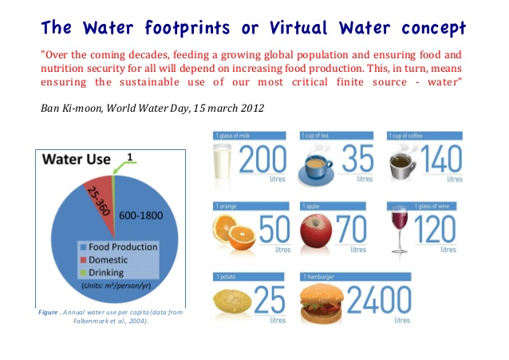
Virtual water trade

Slide 6
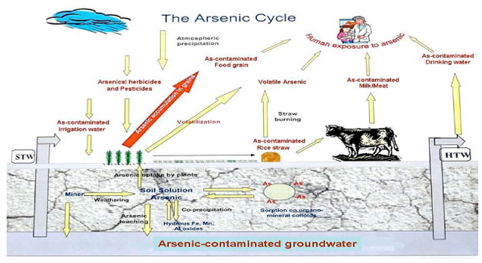
Dirty water: arsenic

Slide 7
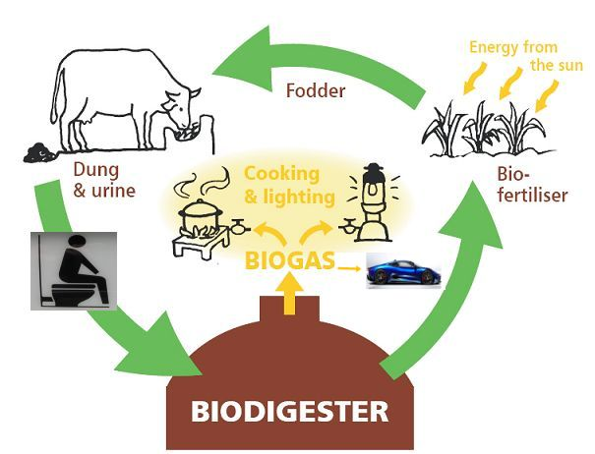
Ecological sanitation

Slide 8
International WASH news services
IRIN – water and sanitation
IISD – Water Policy & Practice - http://water-l.iisd.org
Circle of Blue - www.circleofblue.org
International Decade for Action 'Water for Life' 2005-2015 – Decade’s Weekly - www.un.org/waterforlifedecade/decade_weekly.shtml
Science Daily - Water News - www.sciencedaily.com/news/earth_climate/water
OOSKAnews / aquaNOW - www.ooskanews.com
Global Water Intelligence - www.globalwaterintel.com

Slide 9
IRC News and Information Resources
IRC web site – themes | news | blog | resources (WASH Library)
Sanitation Updates (USAID/IRC)
E-Source Sanitation News
WASH Services that Last

Slide 10
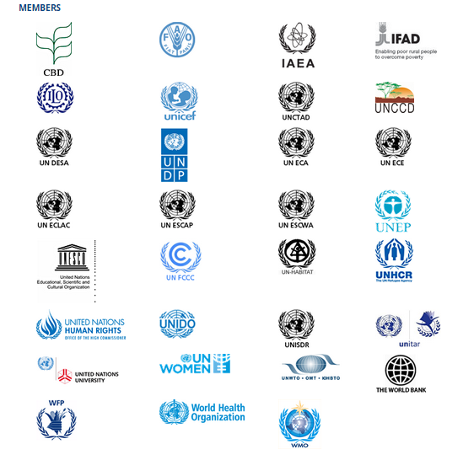
WASH Resources: key international organisations
UN-Water members (1)

Slide 11
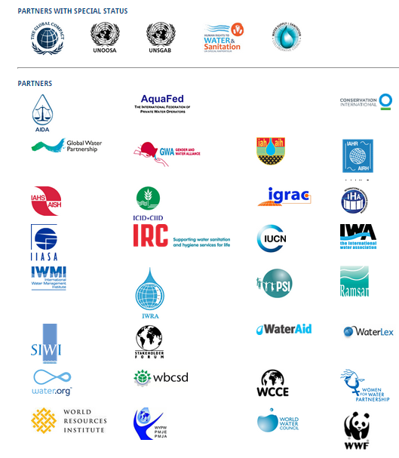
WASH Resources: key international organisations
UN-Water members (2)

Slide 12
WASH Resources: Key events
World Water Forum (Mar)
SWA High Level Meeting (Apr)I
WEDC Conference (Jul)
International Water Week in Stockholm (Aug/Sept)
UNC Water and Health Conference (Oct)
IWA World Water Conference (Sep)

Slide 13
WASH Resources – Key Journals
Journal of Water, Sanitation and Hygiene for Development
Waterlines

Slide 14
WASH Resources – topic starting points (1)
Advocacy – WSSCC | End Water Poverty
Economics - World Bank – Water
Funding – WASHfunders.org
Gender – Gender and Water Alliance
Health – WHO - Water Sanitation Health
Human Rights - Human Rights to Water and Sanitation - UN Special Rapporteur
Hygiene – LSTHM – Hygiene Central
Integrity / anti-corruption – Water Integrity Network

Slide 15
WASH Resources – topic starting points (2)
Monitoring – WASHwatch | WHO/UNICEF JMP
Policy – Sanitation and Water for All
Rural Water Supply - RWSN
Sanitation – SuSanA
Statistics – UN-Water – Statistics | WHO/UNICEF JMP | Improve International - Failures
Sustainable services - IRC | Water for People | WSUP
Technology – Akvopedia
Water Resource s Management - Global Water Partnership

Slide 16
WASH Resources – examples from the South (3)
BRAC WASH Programme
India Water Portal
IWMI – Sri Lanka
Water Research Commission (WRC) – South Africa

